Slide 1
On query complexity measures and their relations for symmetric functions
Sanjay S Nair, IIT Kanpur
Rajat Mittal, IIT Kanpur
Sunayana Patro, IIIT Hyderabad
10th Annual International Conference on Algorithms and Discrete Applied Mathematics, IIT Bhilai

Slide 2
Motivation
Query model can best describe many quantum algorithms and it offers concrete lower bounding techniques.
Ronald de Wolf formulated the quantum query complexity for total symmetric functions.
Spectral sensitivity was found to serve as a lower bound for adversary method and quantum complexity.
We are looking into the adversary bounds of symmetric functions, and the quantum complexity of some partial symmetric functions

Slide 3
Preliminaries
Sensitivity graphs
Quantum Query model
Adversary Method
Spectral sensitivity
Approximate Counting

Slide 4

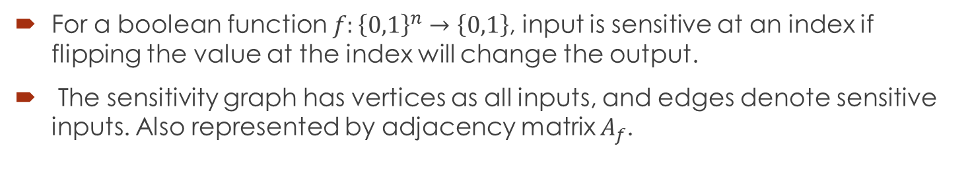
Sensitivity graphs
For a boolean function $f:{\left\{0,1\right\}}^{n}→\left\{0,1\right\}$, input is sensitive at an index if flipping the value at the index will change the output.
The sensitivity graph has vertices as all inputs, and edges denote sensitive inputs. Also represented by adjacency matrix $A_{f}$.
$$OR_{2}$$
O1
OO
11
1O

Slide 5

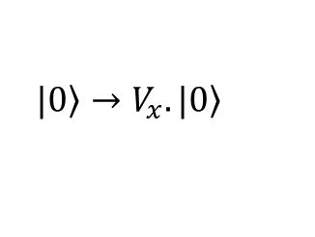
Quantum Query model
Output obtained by series of queries through unitary oracle.
$$\left.|0\right\rangle →V_{x}.\left.|0\right\rangle$$
$$V_{x}=U_{T}O_{x}U_{T−1}O_{x}…O_{x}U_{0}$$

Slide 6
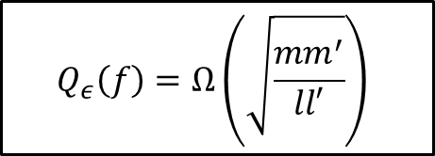
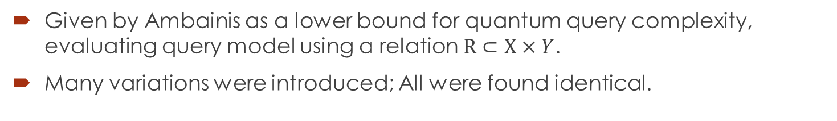
Adversary Method
Given by Ambainis as a lower bound for quantum query complexity, evaluating query model using a relation $R⊂X×Y$.
Many variations were introduced; All were found identical.
$$Q_{ε}\left(f\right)=Ω\left(\sqrt{\frac{mm^{′}}{ll′}}\right)$$

Slide 7
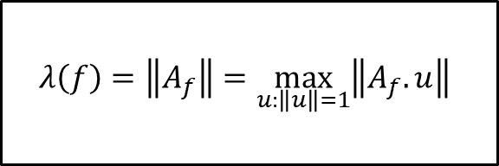
Spectral Sensitivity
Spectral norm of Adjacency matrix of a boolean function.
It was found to be a lower bound for the adversary method by Aaronson et al.
$$λ\left(f\right)=\left\|A_{f}\right\|=\max_{u:\left\|u\right\|=1}\left\|A_{f}.u\right\|$$

Slide 8
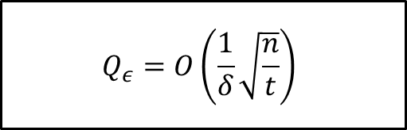
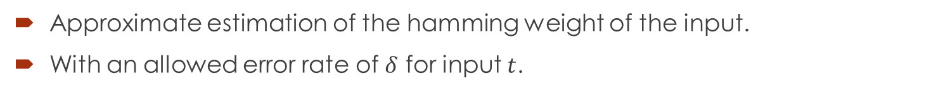
Approximate Counting
Approximate estimation of the hamming weight of the input.
With an allowed error rate of $δ$ for input $t$.
$$Q_{ε}=O\left(\frac{1}{δ}\sqrt{\frac{n}{t}}\right)$$

Slide 9
Results
Spectral sensitivity of threshold functions.
Adversary bound of total symmetric functions.
Quantum complexity of Gap Majority.
Noisy randomised query complexity vs quantum query complexity.

Slide 10
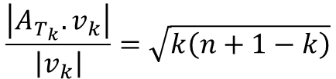
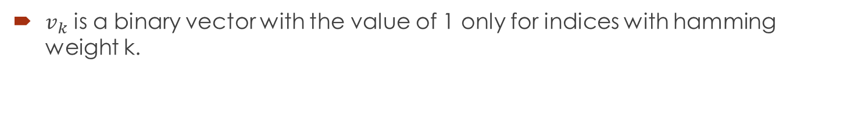
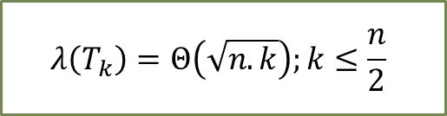
Threshold functions
$v_{k}$ is a binary vector with the value of 1 only for indices with hamming weight k.
0
k
0
1
n
$$\frac{\left|A_{T_{k}}.v_{k}\right|}{\left|v_{k}\right|}=\sqrt{k\left(n+1−k\right)}$$
$$λ\left(T_{k}\right)=Θ\left(\sqrt{n.k}\right);k≤\frac{n}{2}$$

Slide 11


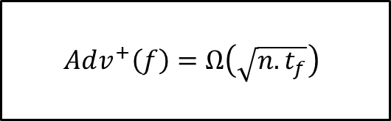
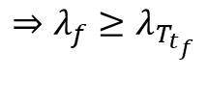
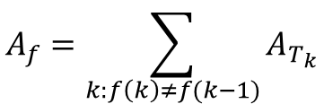
Total symmetric functions
The adjacency matrix of a total symmetric function can be expressed as the sum of the matrices of the constituent threshold functions.
$$t_{f}$$
constant
$${n−t}_{f}$$
0
n
$$A_{f}=\sum_{k:f\left(k\right)≠f(k−1)}{A_{T_{k}}}$$
$$⇒λ_{f}≥λ_{T_{t_{f}}}$$
$$Adv^{+}\left(f\right)=Ω\left(\sqrt{n.t_{f}}\right)$$

Slide 12
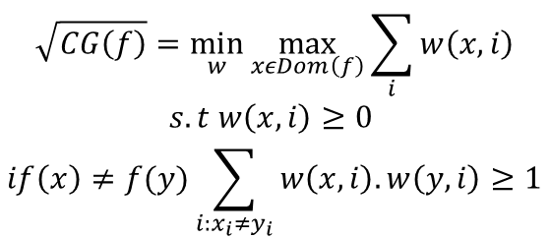
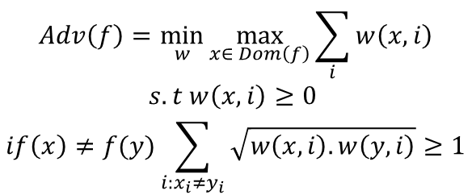
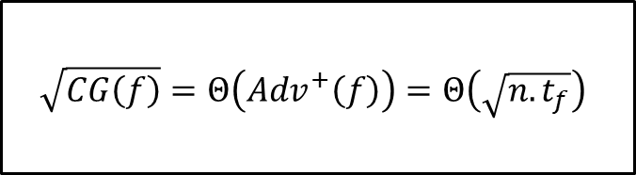
Adversary bound and Certificate Game Complexity
A min-max formulation of adversary shows that it is very similar to the square root of certificate game complexity for symmetric functions.
The weight function gives the same optimal results for both formulations.
$$Adv\left(f\right)=\min_{w}{\max_{x∈ Dom\left(f\right)}{\sum_{i}{w\left(x,i\right)}}}$$
$$s.t w\left(x,i\right)≥0$$
$$if\left(x\right)≠f(y)\sum_{i:x_{i}≠y_{i}}{\sqrt{w\left(x,i\right).w\left(y,i\right)}}≥1$$
$$\sqrt{CG\left(f\right)}=\min_{w}{\max_{xεDom\left(f\right)}{\sum_{i}{w\left(x,i\right)}}}$$
$$s.t w\left(x,i\right)≥0$$
$$if\left(x\right)≠f(y)\sum_{i:x_{i}≠y_{i}}{w\left(x,i\right).w\left(y,i\right)}≥1$$
$$\sqrt{CG\left(f\right)}=Θ\left(Adv^{+}\left(f\right)\right)=Θ\left(\sqrt{n.t_{f}}\right)$$

Slide 13


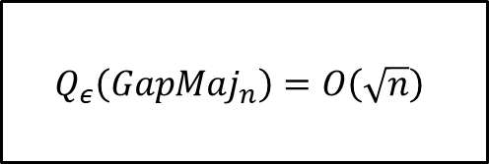

Gap Majority: Quantum algorithm
We look into a new quantum algorithm by approximate counting
To count without overlap, the allowed error rate can be $\frac{1}{\sqrt{n}}$.
$$\frac{n}{2}−\sqrt{n}$$
$$\frac{n}{2}+\sqrt{n}$$
0
n
Ṣ
$$Q_{ε}\left(GapMaj_{n}\right)=O\left(\sqrt{n}\right)$$

Slide 14


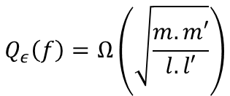

Gap Majority: Lower bound on complexity
The lower bound can be provided by the adversary method.
R is (x,y) such that all bits set in x are also set in y.
0
$$\frac{n}{2}−\sqrt{n}$$
$$\frac{n}{2}+\sqrt{n}$$
n
$$Q_{ε}\left(f\right)=Ω\left(\sqrt{\frac{m.m′}{l.l′}}\right)$$
$$Q_{ε}\left(GapMaj_{n}\right)=Θ\left(\sqrt{n}\right)$$

Slide 15
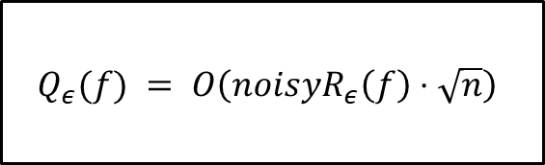
Corollary: Noisy randomised query complexity
We have two known relations for noisy randomised complexity and query complexity related to gap majority for all total boolean functions.
$Q_{ε}(f∘GapMaj_{n}) = O\left(noisyR_{ε}\left(f\right)⋅n\right)$
${Q_{ε}\left(f\right) . Q}_{ε}(GapMaj_{n}) =Θ\left(Q_{ε}(f∘GapMaj_{n})\right)$
$$Q_{ε}(f) = O\left(noisyR_{ε}\left(f\right)⋅\sqrt{n}\right)$$

Slide 16

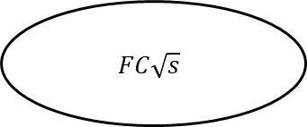

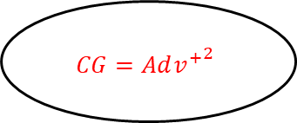
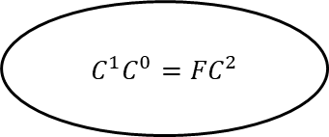

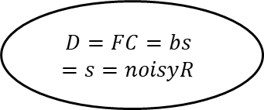

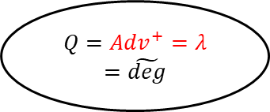

Relations of complexity measures
$$Θ(n^{2})$$
$C^{1}C^{0}={FC}^{2}$
$$Θ(n)$$
$$Θ\left(n.t_{f}\right)$$
$$Θ(n^{3/2})$$
$$D=FC=bs=s=noisyR$$
$$CG={Adv^{+}}^{2}$$
$$FC\sqrt{s}$$
$$Q={Adv}^{+}=λ=\tilde{deg}$$
$$Θ\left(\sqrt{n{.t}_{f}}\right)$$

Slide 17
Future work
Quantum complexity of Gap threshold functions
Adversary bounds for transitive functions.

Slide 18
Literature
Aaronson, S., Ben-David, S., Kothari, R., Rao, S., Tal, A.: Degree vs. approximate degree and quantum implications of huang’s sensitivity theorem. In: STOC ’21
de Wolf, R.: A note on quantum algorithms and the minimal degree of ϵ-error polynomials for symmetric functions. Quantum Inf. Comput. (2008)
Brassard, G., Høyer, P., Mosca, M., Tapp, A.: Quantum amplitude amplification and estimation. Quantum Computation and Information p. 53–74 (2002)
Ambainis, A.: Quantum lower bounds by quantum arguments. In: Proceedings of the 32nd Symposium on Theory of Computing, 2000
Chakraborty, S., Gál, A., Laplante, S., Mittal, R., Sunny, A.: Certificate Games. In: Tauman Kalai, Y. ,14th Innovations in Theoretical Computer Science Conference (ITCS 2023)

Slide 19
Thank you!

