Slide 1
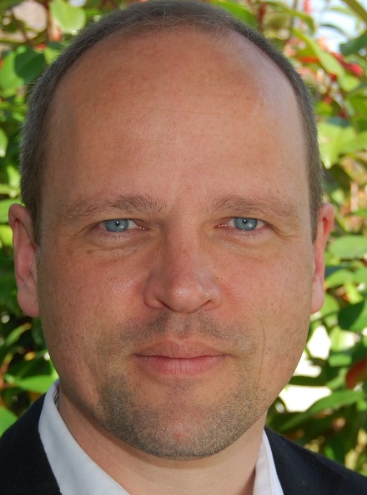

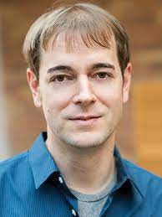
From Approximate to Exact Integer Programming
Daniel Dadush
CALDAM 2023
Friedrich Eisenbrand
EPFL
Thomas Rothvoss
University of Washington

Slide 2
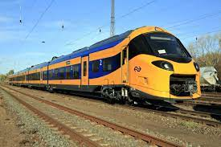

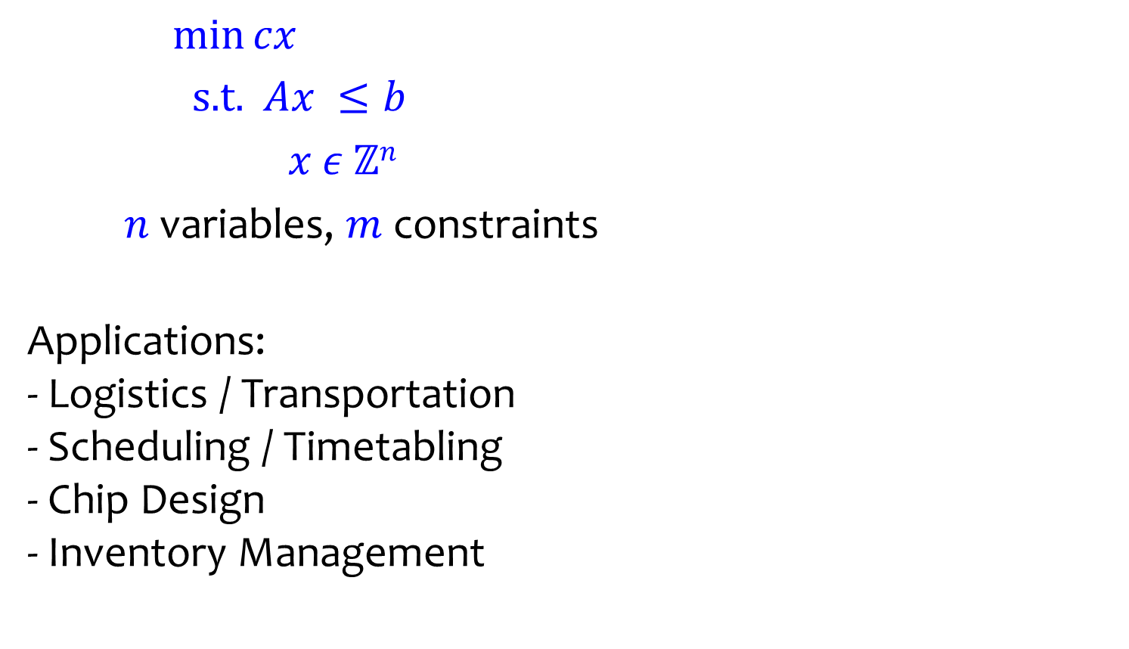

Integer Programming (IP)
$\min{cx}$
$\text{s}\text{.}\text{t}\text{. }Ax ≤b$
$x ε ℤn$
$n$ variables, $m$ constraints
Applications:
- Logistics / Transportation
- Scheduling / Timetabling
- Chip Design
- Inventory Management
$$c$$
$$K$$

Slide 3
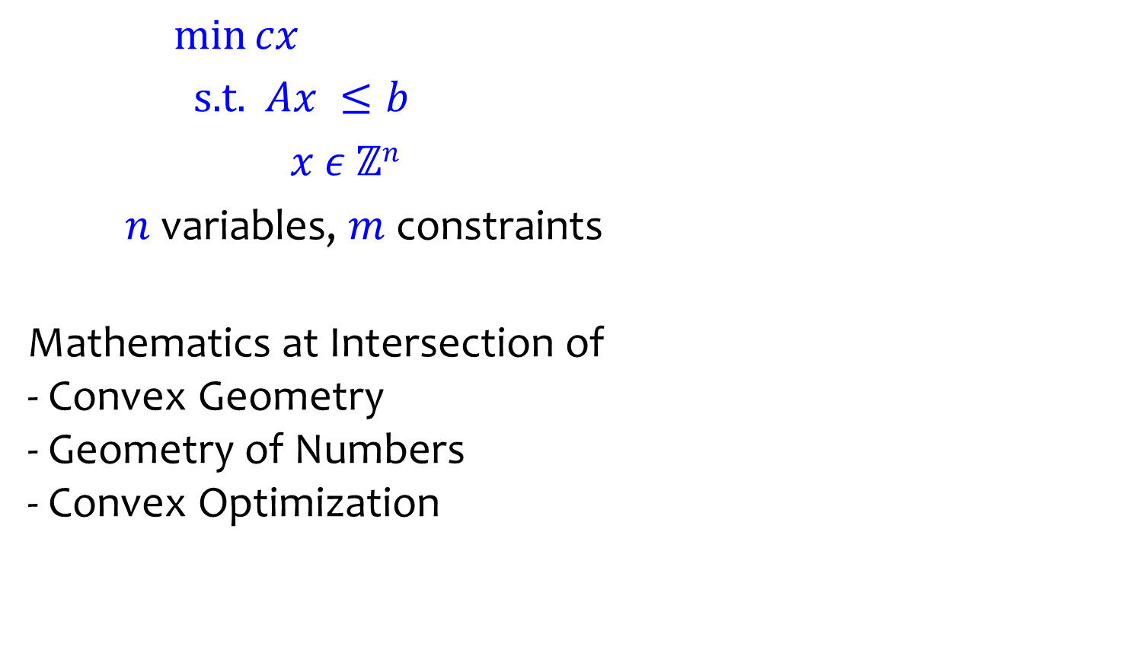

Integer Programming (IP)
$\min{cx}$
$\text{s}\text{.}\text{t}\text{. }Ax ≤b$
$x ε ℤn$
$n$ variables, $m$ constraints
Mathematics at Intersection of
- Convex Geometry
- Geometry of Numbers
- Convex Optimization
$$c$$
$$K$$

Slide 4
Outline
Anatomy of IP Algorithms
Approximate IP and Exact IP
Primer on Lattice Algorithms
Fast IP Algorithms via Approximate IP

Slide 5
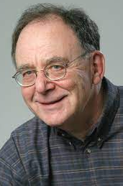
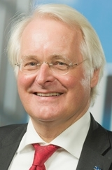
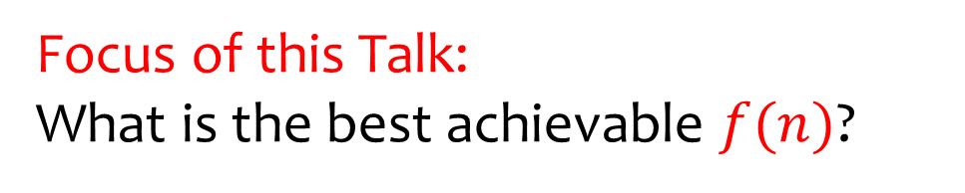
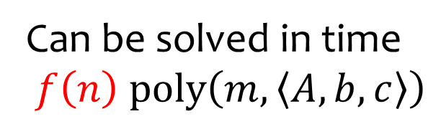
What is the Complexity of IP?
Can be solved in time
$f\left(n\right) poly\left(m,\left\langle A,b,c\right\rangle \right)$
NP-Complete
Encoding length
Karp 1972
Lenstra 1983
Focus of this Talk:
What is the best achievable $f(n)$?

Slide 6
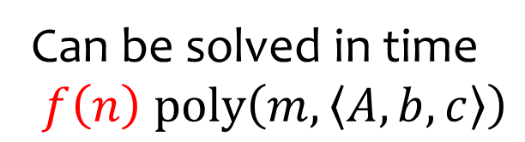
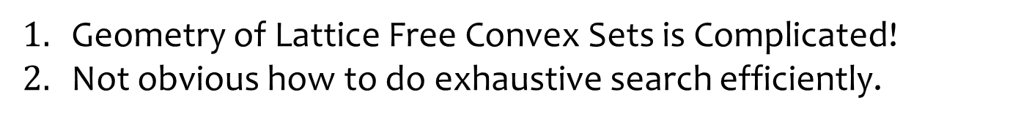

Why is this difficult?
Can be solved in time
$f\left(n\right) poly\left(m,\left\langle A,b,c\right\rangle \right)$
Lenstra 1983
$$ℤ^{2}$$
Geometry of Lattice Free Convex Sets is Complicated!
Not obvious how to do exhaustive search efficiently.

Slide 7



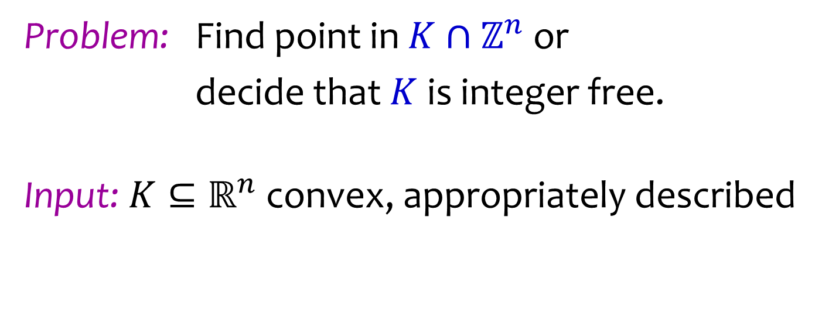
Anatomy of an IP Algorithm
$$y$$
$$K$$
$$ℤ^{n}$$
Problem: Find point in $K∩ℤ^{n}$ or
decide that $K$ is integer free.
Input: $K⊆ℝ^{n}$ convex, appropriately described

Slide 8

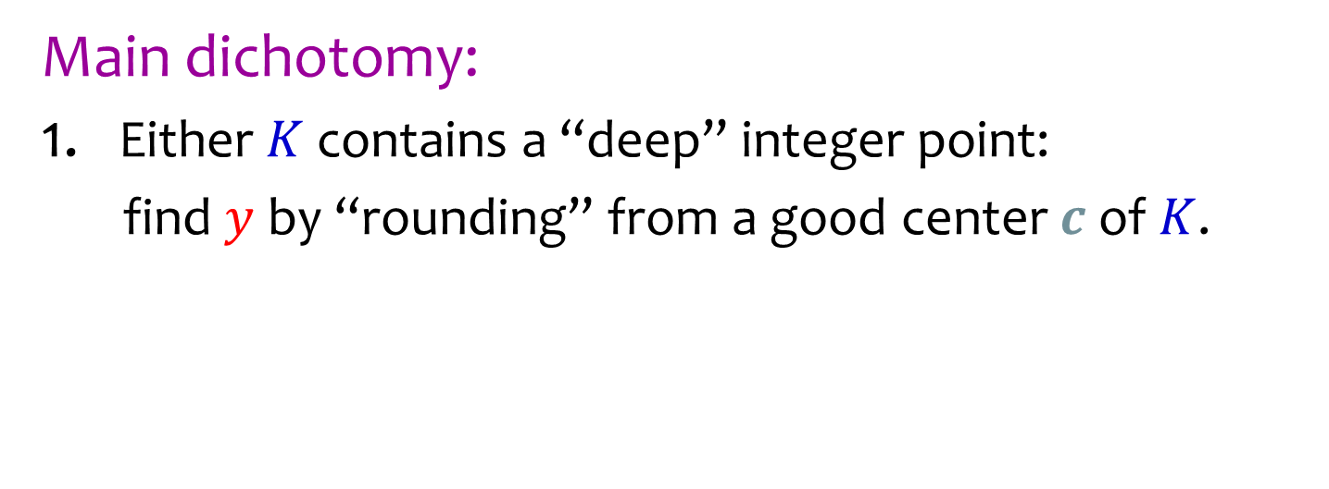
Anatomy of an IP Algorithm
$$y$$
$$K$$
$$c$$
$$ℤ^{n}$$
Main dichotomy:
Either $K$ contains a “deep” integer point:
find $y$ by “rounding” from a good center $c$ of $K$.

Slide 9
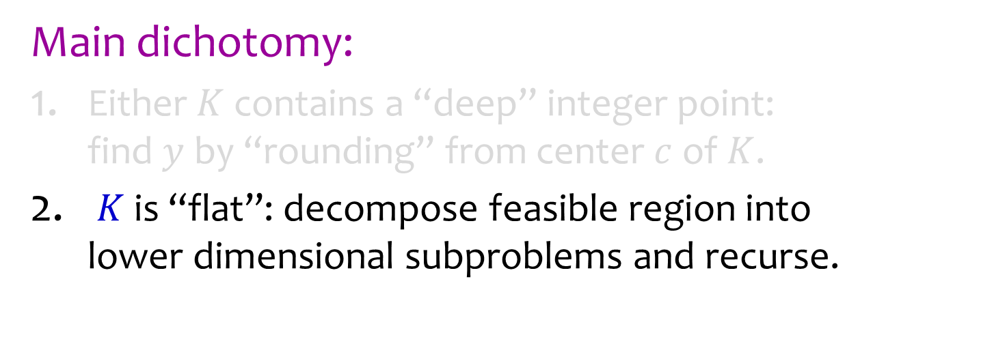



Anatomy of an IP Algorithm
$$x_{2}\text{=}2$$
subproblems
$$K$$
$$x_{2}\text{=}1$$
$$ℤ^{n}$$
Main dichotomy:
Either $K$ contains a “deep” integer point:
find $y$ by “rounding” from center $c$ of $K$.
$K$ is “flat”: decompose feasible region into
lower dimensional subproblems and recurse.

Slide 10

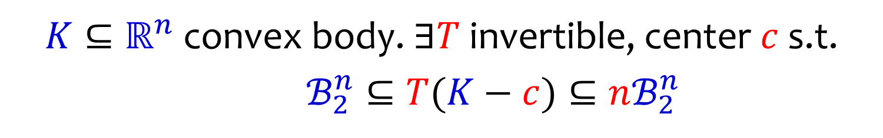

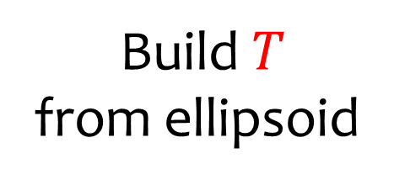

Ellipsoidal Apx: John’s Theorem
$K⊆ℝ^{n}$ convex body. $∃T$ invertible, center $c$ s.t.
$ℬ_{2}^{n}⊆T(K−c)⊆nℬ_{2}^{n}$
$$K$$
$$c$$
Build $T$
from ellipsoid
$$ℤ^{n}$$

Slide 11

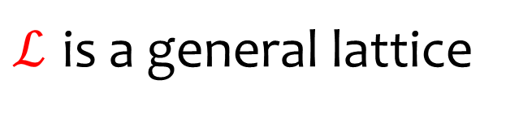





Ellipsoidal Apx: John’s Theorem
$K⊆ℝ^{n}$ convex body. $∃T$ invertible, center $c$ s.t.
$ℬ_{2}^{n}⊆T(K−c)⊆nℬ_{2}^{n}$
Apply Transformation
$$T(K−c)$$
$$n$$
$$1$$
$$0$$
$$ℬ_{2}^{n}$$
$$ℒ=Tℤ^{n}$$
$ℒ$ is a general lattice

Slide 12


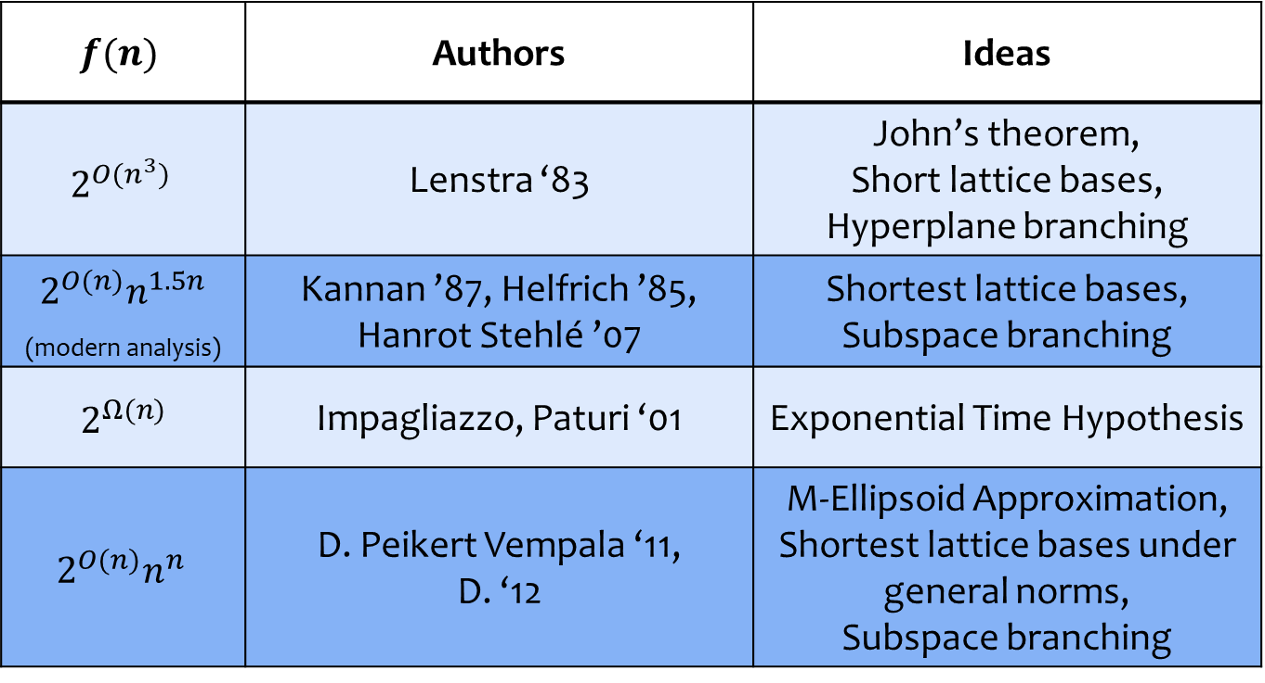
Upper and lower bounds on $f(n)$
$$f(n)$$ | Authors | Ideas
$$2^{O(n^{3})}$$ | Lenstra ‘83 | John’s theorem, Short lattice bases, Hyperplane branching
$2^{O(n)}n^{1.5n}$ _{(modern analysis)} | Kannan ’87, Helfrich ’85, Hanrot Stehlé ’07 | Shortest lattice bases, Subspace branching
$$2^{Ω(n)}$$ | Impagliazzo, Paturi ‘01 | Exponential Time Hypothesis
$$2^{O(n)}n^{n}$$ | D. Peikert Vempala ‘11, D. ‘12 | M-Ellipsoid Approximation, Shortest lattice bases under general norms, Subspace branching
Open Question: $f\left(n\right)=2^{Θ(n)}$?

Slide 13




Current IP Algorithms
$$n^{O(1)}$$
Recursion Tree
$$n^{O(1)}$$
…………...
$$n^{O(1)}$$
…………...
$$n^{O(1)}$$
…………...
$f\left(n\right)$ controlled by # of nodes $=n^{O(n)}$.

Slide 14





$f\left(n\right)=2^{O(n)}$?
$$O(1)$$
Recursion Tree
$$O(1)$$
…………...
$$O(1)$$
…………...
$$O(1)$$
…………...
$f(n)$ controlled by # of nodes $=2^{O(n)}$.

Slide 15
Outline
Anatomy of IP Algorithms
Approximate IP and Exact IP
Primer on Lattice Algorithms
Fast IP Algorithms via Approximate IP

Slide 16

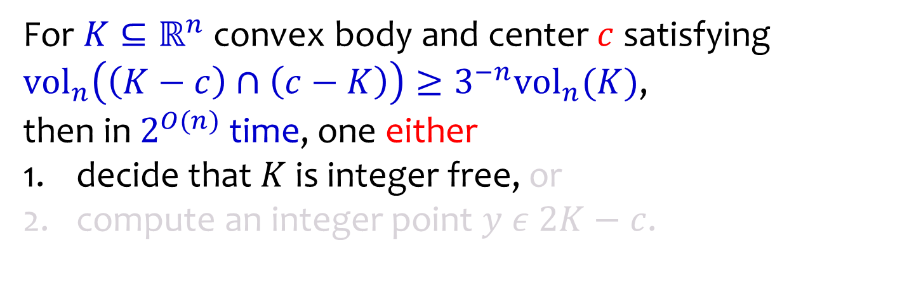


Approximate IP [D. 14, D. Kun 16]
For $K⊆ℝ^{n}$ convex body and center $c$ satisfying
${vol}_{n}\left(\left(K−c\right)∩\left(c−K\right)\right)≥3^{−n}{vol}_{n}(K)$,
then in $2^{O(n)}$ time, one either
decide that $K$ is integer free, or
compute an integer point $y ε 2K−c$.
$$ℤ^{n}$$
$$c$$
$$K$$

Slide 17
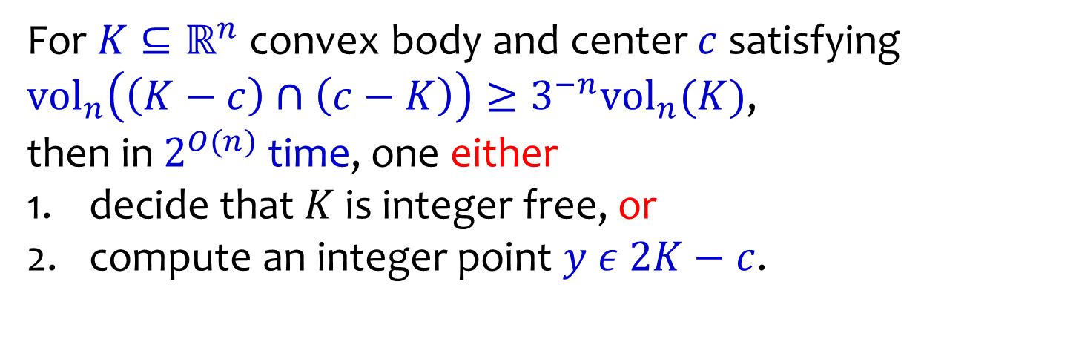


Approximate IP [D. 14, D. Kun 16]
For $K⊆ℝ^{n}$ convex body and center $c$ satisfying
${vol}_{n}\left(\left(K−c\right)∩\left(c−K\right)\right)≥3^{−n}{vol}_{n}(K)$,
then in $2^{O(n)}$ time, one either
decide that $K$ is integer free, or
compute an integer point $y ε 2K−c$.
$$2K−c$$
$$ℤ^{n}$$
$$c$$
$$y$$
$$K$$

Slide 18

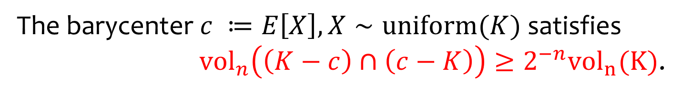
Milman Pajor ‘00
The barycenter $c ≔E\left[X\right], X∼uniform(K)$ satisfies
${vol}_{n}\left(\left(K−c\right)∩\left(c−K\right)\right)≥2^{−n}{vol}_{n}(K)$.
$$c$$
$$K$$

Slide 19


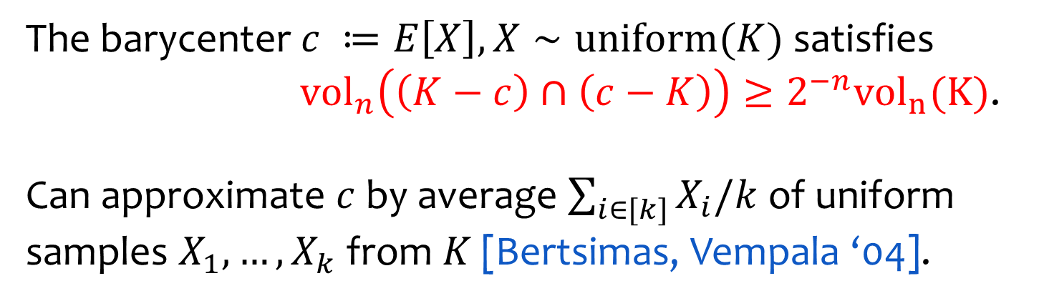


Milman Pajor ‘00
The barycenter $c ≔E\left[X\right], X∼uniform(K)$ satisfies
${vol}_{n}\left(\left(K−c\right)∩\left(c−K\right)\right)≥2^{−n}{vol}_{n}(K)$.
Can approximate $c$ by average $\sum_{i∈[k]}{X_{i}/k}$of uniform samples $X_{1},…,X_{k}$ from $K$ [Bertsimas, Vempala ‘04].
$$X_{2}$$
$$X_{3}$$
$$c$$
$$X_{1}$$
$$X_{4}$$
$$K$$

Slide 20




Approximate to Exact IP?
Approx IP is a ``near miss’’, but still loses a lot of info.
Is there a way to reduce exact IP to approximate IP?
$$(\text{1+}\text{ϵ})K$$
$$K$$
$$x$$
$$y$$

Slide 21
Outline
Anatomy of IP Algorithms
Approximate IP and Exact IP
Primer on Lattice Algorithms
Fast IP Algorithms via Approximate IP

Slide 22



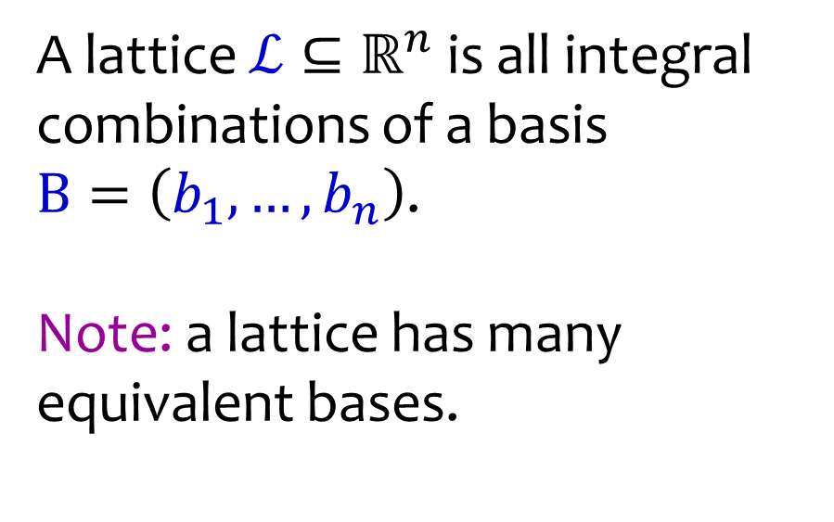



Lattices
A lattice $ℒ⊆ℝ^{n}$ is all integral combinations of a basis
$B=\left(b_{1},…,b_{n}\right)$.
Note: a lattice has many equivalent bases.
$$b_{2}$$
$$b_{1}$$
$$b_{2}$$
$$b_{1}$$
$$b_{2}$$
$$ℒ$$

Slide 23
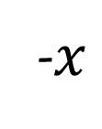
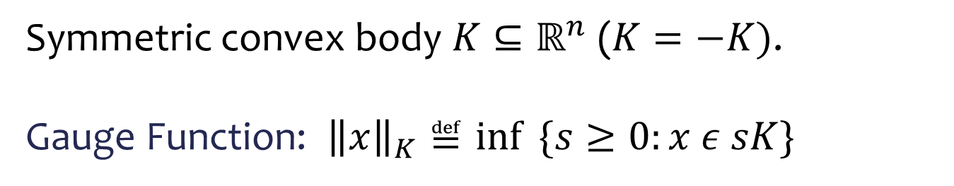



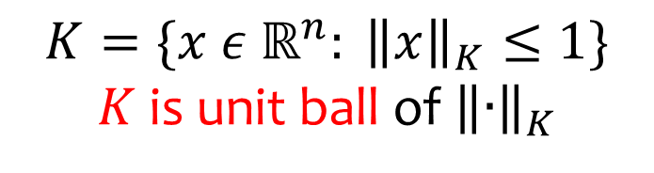

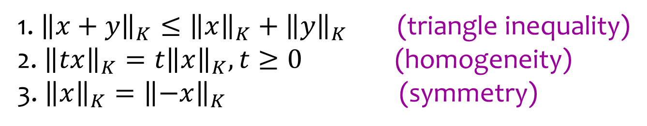
Norms and Convex Bodies
Symmetric convex body $K⊆ℝ^{n}$ ($K=−K)$.
Gauge Function: ${\left\|x\right\|}_{K}≝\inf{ \{s≥0:x ε sK\}}$
$$x$$
$$sK$$
$$K$$
$$K=\{x ε ℝ^{n}: {\left\|x\right\|}_{K}≤1\}$$
$K$ is unit ball of ${\left\|∙\right\|}_{K}$
$$0$$
-$x$
1. ${\left\|x+y\right\|}_{K}≤{\left\|x\right\|}_{K}+{\left\|y\right\|}_{K}$ (triangle inequality)
2.${\left\|tx\right\|}_{K}=t{\left\|x\right\|}_{K}, t≥0$ (homogeneity)
3. ${\left\|x\right\|}_{K}={\left\|−x\right\|}_{K}$ (symmetry)

Slide 24


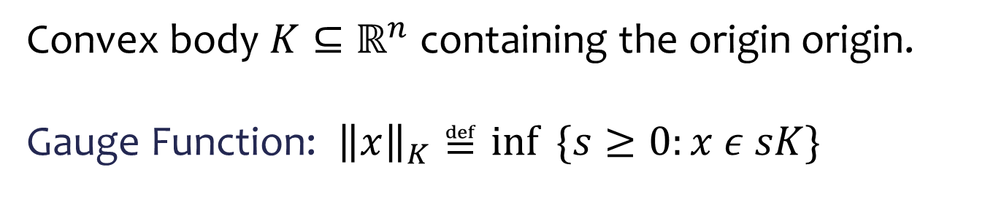



Norms and Convex Bodies
Convex body $K⊆ℝ^{n}$ containing the origin origin.
Gauge Function: ${\left\|x\right\|}_{K}≝\inf{ \{s≥0:x ε sK\}}$
$$x$$
$$sK$$
$$K$$
$$K=\{x ε ℝ^{n}: {\left\|x\right\|}_{K}≤1\}$$
$K$ is unit ball of ${\left\|∙\right\|}_{K}$
$$0$$
1. ${\left\|x+y\right\|}_{K}≤{\left\|x\right\|}_{K}+{\left\|y\right\|}_{K}$ (triangle inequality)
2.${\left\|tx\right\|}_{K}=t{\left\|x\right\|}_{K}, t≥0$ (homogeneity)
3. ${\left\|x\right\|}_{K}={\left\|−x\right\|}_{K}$ (symmetry)

Slide 25
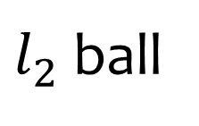

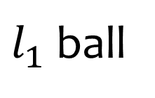






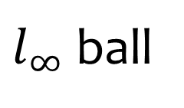
Norms and Convex Bodies
$l_{p}$ norms, $p≥1$: ${\left\|x\right\|}_{p}={\left(∑{|x_{i}|}_{}^{p}\right)}^{1/p}$
$l_{1}$ ball
$l_{2}$ ball
$l_{∞}$ ball
$$0$$
$$0$$
$$0$$
$$B_{1}^{n}$$
$$B_{2}^{n}$$
$$B_{∞}^{n}$$

Slide 26
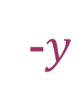

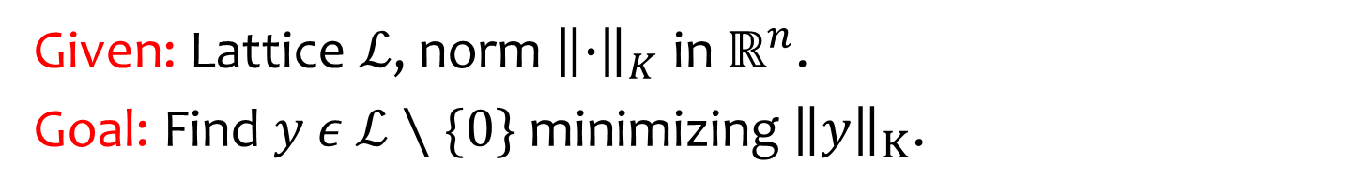



Shortest Vector Problem (SVP)
Given: Lattice $ℒ$, norm ${\left\|∙\right\|}_{K}$ in $ℝ^{n}$.
Goal: Find $y ε$ $ℒ∖\{0\}$ minimizing ${\left\|y\right\|}_{K}$.
$$y$$
$$K$$
$$0$$
$$ℒ$$
-$y$

Slide 27

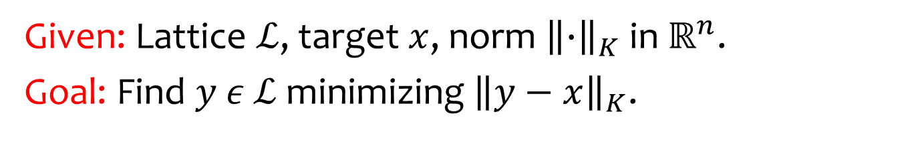


Closest Vector Problem (CVP)
Given: Lattice $ℒ$, target $x$, norm ${\left\|∙\right\|}_{K}$ in $ℝ^{n}$.
Goal: Find $y ε$ $ℒ$ minimizing ${\left\|y−x\right\|}_{K}$.
$$K$$
$$y$$
$$x$$
$$ℒ$$

Slide 28












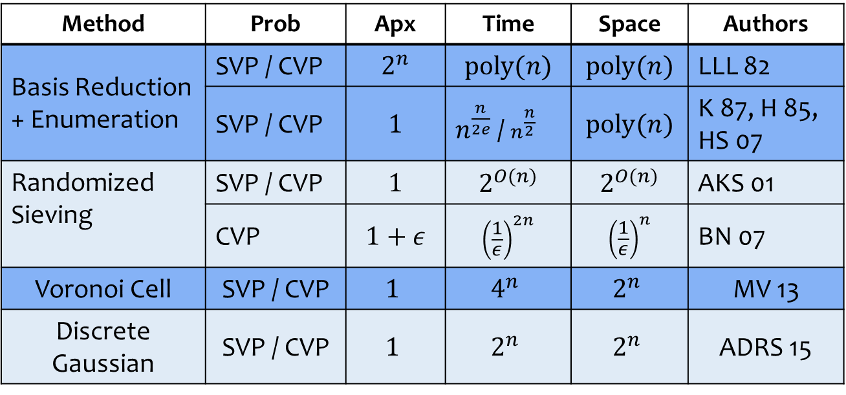


SVP & CVP in $ℓ_{2}$
Method | Prob | Apx | Time | Space | Authors
Basis Reduction + Enumeration | SVP / CVP | $$2^{n}$$ | $$poly(n)$$ | $$poly(n)$$ | LLL 82
 | SVP / CVP | $$1$$ | $n^{\frac{n}{2e}}$ / $n^{\frac{n}{2}}$ | $$poly(n)$$ | K 87, H 85, HS 07
Randomized Sieving | SVP / CVP | $$1$$ | $$2^{O(n)}$$ | $$2^{O(n)}$$ | AKS 01
 | CVP | $$1+ε$$ | $${\left(\frac{1}{ε}\right)}^{2n}$$ | $${\left(\frac{1}{ε}\right)}^{n}$$ | BN 07
Voronoi Cell | SVP / CVP | $$1$$ | $$4^{n}$$ | $$2^{n}$$ | MV 13
Discrete Gaussian | SVP / CVP | $$1$$ | $$2^{n}$$ | $$2^{n}$$ | ADRS 15
$$x_{5}$$
$$x_{8}$$
$$x_{2}$$
$$t$$
$$x_{7}$$
$$x$$
$$x_{3}$$
$$0$$
$$x_{9}$$
$$0$$
$$x_{4}$$
$$x_{1}$$
$$x_{6}$$

Slide 29
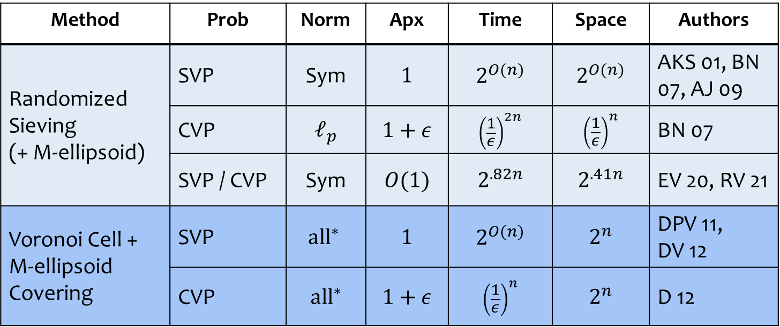
SVP & CVP in general norms
Method | Prob | Norm | Apx | Time | Space | Authors
Randomized Sieving (+ M-ellipsoid) | SVP | Sym | $$1$$ | $$2^{O(n)}$$ | $$2^{O(n)}$$ | AKS 01, BN 07, AJ 09
 | CVP | $$ℓ_{p}$$ | $$1+ε$$ | $${\left(\frac{1}{ε}\right)}^{2n}$$ | $${\left(\frac{1}{ε}\right)}^{n}$$ | BN 07
 | SVP / CVP | Sym | $$O(1)$$ | $$2^{.82n}$$ | $$2^{.41n}$$ | EV 20, RV 21
Voronoi Cell + M-ellipsoid Covering | SVP | $$\text{al}{\text{l}}^{∗}$$ | $$1$$ | $$2^{O(n)}$$ | $$2^{n}$$ | DPV 11, DV 12
 | CVP | $$\text{al}{\text{l}}^{∗}$$ | $$1+ε$$ | $${\left(\frac{1}{ε}\right)}^{n}$$ | $$2^{n}$$ | D 12
${\text{all}}^{∗}$: $K$ is “near-symmetric” ($\text{vol}\left(K\right)≤3^{n}vol(K∩\text{−}K)$).

Slide 30



Randomized Sieve [Ajtai-Kumar-Sivakumar `00]
Main option for solving lattice problems in more general norms than $l_{2}$.
$$K$$
$$0$$

Slide 31
Randomized Sieve [Ajtai-Kumar-Sivakumar `00]
How it works for SVP.
$$K$$
$$0$$

Slide 32










Randomized Sieve [Ajtai-Kumar-Sivakumar `00]
How it works for SVP.
Algorithm Outline:
Sample $2^{O\left(n\right)}$ “perturbed” lattice points.
$$x_{5}$$
$$x_{2}$$
$$x_{8}$$
$$x_{7}$$
$$0$$
$$rK$$
$$x_{9}$$
$$x_{3}$$
$$x_{6}$$
$$x_{4}$$
$$x_{1}$$

Slide 33


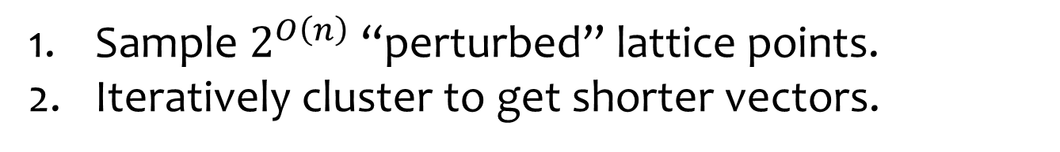

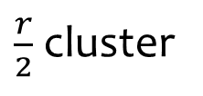
Randomized Sieve [Ajtai-Kumar-Sivakumar `00]
How it works for SVP.
Algorithm Outline:
Sample $2^{O\left(n\right)}$ “perturbed” lattice points.
Iteratively cluster to get shorter vectors.
$\frac{r}{2}$ cluster
$$x_{5}$$
$$x_{2}$$
$$x_{8}$$
$$x_{7}$$
$$0$$
$$rK$$
$$x_{9}$$
$$x_{3}$$
$$x_{6}$$
$$x_{4}$$
$$x_{1}$$

Slide 34






Randomized Sieve [Ajtai-Kumar-Sivakumar `00]
How it works for SVP.
Algorithm Outline:
Sample $2^{O\left(n\right)}$ “perturbed” lattice points.
Iteratively cluster to get shorter vectors.
$$x_{7}$$
$$x_{5}$$
$$x_{4}$$
$$x_{3}$$
$$x_{8}$$
$$x_{2}$$
$$x_{9}$$
$$0$$
$$rK$$
$$x_{6}$$
$$x_{1}$$
Lost vectors
Bounded number lost
(packing argument)

Slide 35
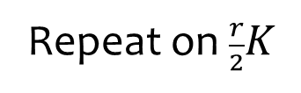

Randomized Sieve [Ajtai-Kumar-Sivakumar `00]
How it works for SVP.
Algorithm Outline:
Sample $2^{O\left(n\right)}$ “perturbed” lattice points.
Iteratively cluster to get shorter vectors.
$$x_{7}$$
Repeat on $\frac{r}{2}K$
$$x_{5}$$
$$x_{4}$$
$$x_{2}$$
$$x_{9}$$
$$0$$
$$\frac{r}{2}K$$
$$x_{1}$$

Slide 36

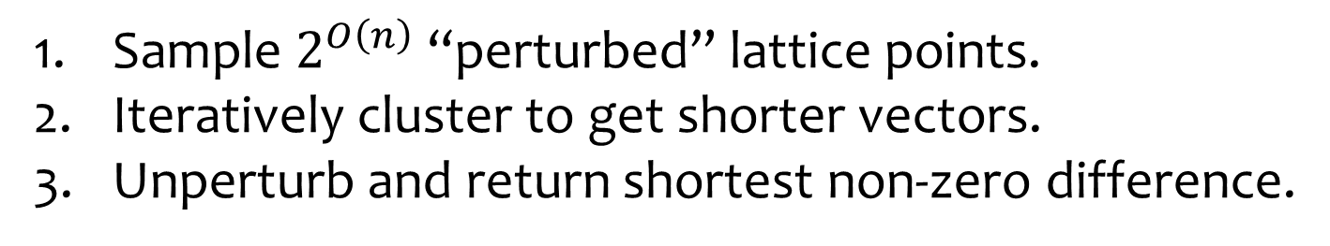
Randomized Sieve [Ajtai-Kumar-Sivakumar `00]
How it works for SVP.
Algorithm Outline:
Sample $2^{O\left(n\right)}$ “perturbed” lattice points.
Iteratively cluster to get shorter vectors.
Unperturb and return shortest non-zero difference.
$$x_{7}$$
$$x_{5}$$
$$x_{4}$$
$$x_{2}$$
$$x_{9}$$
$$K$$
$$0$$
$$x_{1}$$

Slide 37
Randomized Sieve [Ajtai-Kumar-Sivakumar `00]
How it works for SVP.
Algorithm Outline:
Sample $2^{O\left(n\right)}$ “perturbed” lattice points.
Iteratively cluster to get shorter vectors.
Unperturb and return shortest non-zero difference.
$$x_{5}$$
$$x_{7}$$
$$x_{4}$$
$$x_{9}$$
$$K$$
$$x_{2}$$
$$x_{1}$$
$$0$$

Slide 38
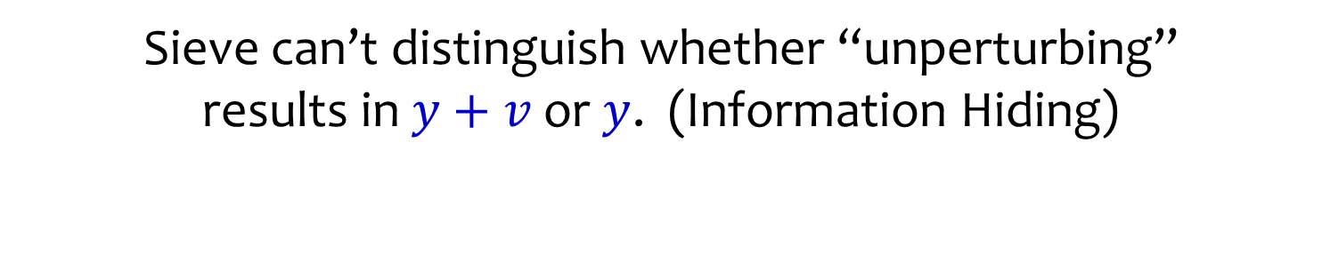


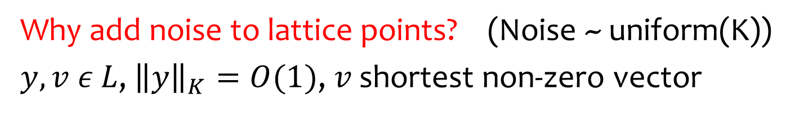




Randomized Sieve [Ajtai-Kumar-Sivakumar `00]
Why add noise to lattice points? (Noise ~ uniform(K))
$y,v ε L$, ${\left\|y\right\|}_{K}=O(1)$, $v$ shortest non-zero vector
$$K$$
$$y\text{+}v$$
$$y$$
$$v$$
$$K$$
$$0$$
Uncertainty region
Sieve can’t distinguish whether “unperturbing”
results in $y+v$ or $y$. (Information Hiding)

Slide 39
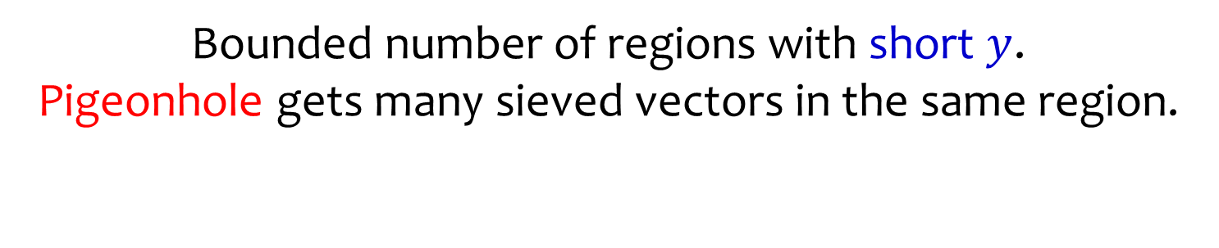


Randomized Sieve [Ajtai-Kumar-Sivakumar `00]
Why add noise to lattice points? (Noise ~ uniform(K))
$y,v ε L$, ${\left\|y\right\|}_{K}=O(1)$, $v$ shortest non-zero vector
$$x_{3}$$
$$K$$
$$x_{2}$$
$$y\text{+}v$$
$$y$$
$$v$$
$$K$$
$$x_{1}$$
$$0$$
Uncertainty region
Bounded number of regions with short $y$.
Pigeonhole gets many sieved vectors in the same region.

Slide 40
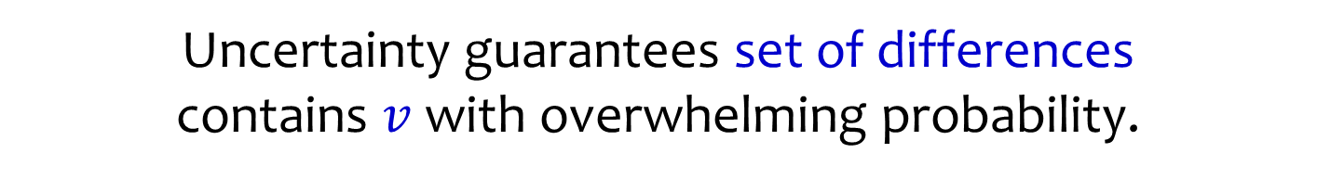
Randomized Sieve [Ajtai-Kumar-Sivakumar `00]
Why add noise to lattice points? (Noise ~ uniform(K))
$y,v ε L$, ${\left\|y\right\|}_{K}=O(1)$, $v$ shortest non-zero vector
$$x_{3}$$
$$K$$
$$x_{2}$$
$$y\text{+}v$$
$$y$$
$$v$$
$$K$$
$$x_{1}$$
$$0$$
Uncertainty region
Uncertainty guarantees set of differences
contains $v$ with overwhelming probability.

Slide 41



Randomized Sieve [Ajtai-Kumar-Sivakumar `00]
Why add noise to lattice points? (Noise ~ uniform(K))
$y,v ε L$, ${\left\|y\right\|}_{K}=O(1)$, $v$ shortest non-zero vector
$$K$$
$$x_{2}$$
$$x_{3}$$
$$y\text{+}v$$
$$y$$
$$x_{1}$$
$$v$$
$$K$$
$$0$$
Uncertainty region
Uncertainty guarantees set of differences
contains $v$ with overwhelming probability.

Slide 42
Randomized Sieve [Ajtai-Kumar-Sivakumar `00]
Why add noise to lattice points? (Noise ~ uniform(K))
$y,v ε L$, ${\left\|y\right\|}_{K}=O(1)$, $v$ shortest non-zero vector
$$K$$
$$x_{2}$$
$$x_{3}$$
$$y\text{+}v$$
$$y$$
$$x_{1}$$
$$v$$
$$K$$
$$0$$
Uncertainty region
What about CVP? Same with homogenization trick.
Can only guarantee many sieved vectors
land in “union” of uncertainty regions.
(hence only get approximate solution)

Slide 43
Outline
Anatomy of IP Algorithms
Approximate IP and Exact IP
Primer on Lattice Algorithms
Fast IP Algorithms via Approximate IP

Slide 44

Standard form IPs with Bounded Vars
D., Eisenbrand, Rothvoss 22:
$$Ax=b, 0≤x≤u, x∈ℤ^{n}$$
Can determine whether the system is infeasible or find an integer solution using at most
$2^{n}\prod_{i=1}^{n}{⌈\log_{2}\left(u_{i}\right)+1⌉}$
calls to an approx-IP solver.
Faster than worst-case if $\max_{i}{u_{i}}=2^{o(n)}$.

Slide 45

Partition Domain into Reflection Sets
Cook, Hartmann, Kannan, Mcdiarmid ‘92

Slide 46

Partition Domain into Reflection Sets
For simplicity assume $u_{i}=2^{k_{i}}, k_{i}≥0$.
For $i∈\left[n\right]$, examine family of intervals
$ℐ_{i}=\{[0,\frac{1}{2}],[u_{i}−\frac{1}{2},u_{i}],$
$$\left[2^{j−1},2^{j}\right], [u_{i}−2^{j},u_{i}−2^{j−1}], 0≤j<k_{i}\}$$
Key Facts:
1. $\left|ℐ_{i}\right|=2k_{i}+2=2(\log_{2}{u_{i}}+1)$
2. $\left[0,u_{i}\right]=∪_{I∈ℐ_{i}}I$ (partitions domain)
3. $2I−I⊆(−1,u_{i}+1), ∀I∈ℐ_{i}$ (scaling safe)

Slide 47

Key Reflection Set Property
3. $2I−I⊆\left(−1,u_{i}+1\right), ∀I∈ℐ_{i}$ (scaling safe)
Implies $\left(2I−I\right)∩ℤ⊆\{0,1,…,u_{i}\}$
Proof:
$2\left[0,\frac{1}{2}\right]−\left[0,\frac{1}{2} \right]=[−\frac{1}{2},1]⊆(−1,u_{i}]$
$2\left[2^{j−1},2^{j}\right]−\left[2^{j−1},2^{j}\right]=\left[{0,2}^{j+1}−2^{j−1}\right]$
$$⊆[0,u_{i}]$$

Slide 48

Algorithm
For each combination $I_{i}∈ℐ_{i}$, $i∈[n]$
Compute barycenter c of polytope
$P ≔\{Ax=b, x_{i}∈J_{i}$, $i∈[n]\}$
Solve Approx-IP on $P$ with center $c$.
If any call returns a feasible solution to original problem return it, otherwise declare infeasibility.

Slide 49

Algorithm
For each combination $I_{i}∈ℐ_{i}$, $i∈[n]$
Compute barycenter c of polytope
$P ≔\{Ax=b, x_{i}∈J_{i}$, $i∈[n]\}$
Solve Approx-IP on $P$ with center $c$.
Correctness: If IP is feasible, then it is feasible for some choice $I_{i}∈𝒥_{i}, i∈[n]$ above.
This choice must return $y∈(2P−c)∩ℤ^{n}$, which is feasible for original by construction.

Slide 50

Algorithm
For each combination $I_{i}∈ℐ_{i}$, $i∈[n]$
Compute barycenter c of polytope
$P ≔\{Ax=b, x_{i}∈J_{i}$, $i∈[n]\}$
Solve Approx-IP on $P$ with center $c$.
Number of calls to Approx-IP:
$\prod_{i=1}^{n}{\left|ℐ_{i}\right|≤2^{n} \prod_{i=1}^{n}{⌈\log_{2}{u_{i}}+1⌉}}$

Slide 51








Sublattice IP
D., Eisenbrand, Rothvoss 22:
$K⊆RB_{2}^{n}$ convex, can either decide that
$K∩{6nℤ}^{n}=∅$ or find point in $K∩ℤ^{n}$ in expected $poly(n)\log{R}$ calls to Approx IP.
$$v_{1}$$
$$v_{2}$$
$$y$$
$$y=\frac{v_{1}+v_{2}+v_{3}}{3}$$
$$K$$
$$v_{3}$$
$$3ℤ^{n}$$

Slide 52


IP reduces to ${\left(6n\right)}^{n}$ sublattice IPs
For each $x∈{\left\{0,1,…,6n−1\right\}}^{n}$
(guess residues mod 6n)
call sublattice IP on $K−x$ and $6nℤ^{n}$
if $y ∈(K−x)∩ℤ^{n}$ is returned, return $y+x$.
If all sublattice IPs return empty, then $K∩ℤ^{n}=∅$.
Running Time: ${\left(6n\right)}^{n}2^{O(n)}=2^{O(n)}n^{n}.$
Remark: all branching is done at beginning!

Slide 53
Sublattice IP
D., Eisenbrand, Rothvoss 22:
$K⊆RB_{2}^{n}$ convex, can either decide that
$K∩{6nℤ}^{n}=∅$ or find point in $K∩ℤ^{n}$ in expected $poly(n)\log{R}$ calls to Approx IP.
$$v_{1}$$
$$v_{2}$$
$$y$$
$$y=\frac{v_{1}+v_{2}+v_{3}}{3}$$
$$K$$
$$v_{3}$$
$$3ℤ^{n}$$

Slide 54





Main Subroutine: Cut or Average
Remove constant fraction of $vol_{n}\left(K\right)$
(Grunbaüm 60)
$$⊆6nℤ^{n}∩\left(3K−c\right)$$
$c$ barycenter of $K$
Either nearly separate $c$ from $convex hull(X)$, or
find $z∈K∩ℤ^{n}$ as average of $6n$ points in $X$.

Slide 55





Main Subroutine: Cut or Average
$$⊆ℒ∩\left(3K′−c\right)$$
Rounded body $K^{′}=TB$
$B_{2}^{n}⊆K^{′}−c⊆nB_{2}^{n}$
Lattice $ℒ=6nTℤ^{n}$
$z≔\sum_{x∈X}{x/\left|X\right|}$
$d≔\frac{c−z}{||c−z||}$, $ρ≔\frac{1}{4n}$
$c$ barycenter of $K′$
While $\left\|c−z\right\|≥\frac{1}{4}$, call ApproxIP on lattice $ℒ$
$Q ≔\left\{x∈K^{′}:\left\langle x, d\right\rangle ≥\left\langle c,d\right\rangle +\frac{ρ}{2}\right\}$ and center $c+ρd$.
If returns $x′∈ℒ,$add $x′$ to $X$.
Otherwise replace $K′$ by $\{x∈K^{′}:\left\langle x, d\right\rangle ≤\left\langle c,d\right\rangle +\frac{ρ}{2}$} and
end loop.

Slide 56

Idea of Analysis
Invariant: $|{\left|z−c|\right|}_{2}^{2}≤\frac{9n^{2}}{\left|X\right|},$ where $z≔\sum_{x∈X}{x/\left|X\right|}$.
Reason: each time we add $x′$ to $X$, it
satisfies $\left\langle z−c,x′−c\right\rangle ≤0$ and $||x^{′}−c||_{2}^{2}≤9n^{2}$.
Thus, we terminate in at most $O(n^{2})$ iterations.

Slide 57

Idea of Analysis
Case 1: $||z−c||≤1/4$ at termination
Then, $z∈\frac{K^{′}−c}{4}+c$ but possibly $\left|X\right|≠6n$.
Use an Approximate Carathéodory Lemma to select
$X′⊆X$ (possibly with repetition) so that
$\left|X′\right|=6n$ and $z^{′}≔\sum_{x∈X^{′}}{\frac{x}{6n}∈K^{′}}$.
Then, $T^{−1}z^{′}∈K∩ℤ^{n}$.

Slide 58









Approximate Carathéodory
D., Eisenbrand, Rothvoss 22:
Let $X=\left\{v_{1},…,v_{m}\right\}⊆ℝ^{n}$, $convex hull\left(X\right)≔C$.
Let $λ≥0, \sum_{i=1}^{m}{λ_{i}=1}$ satisfy $\sum_{i=1}^{m}{λ_{i}v_{i}}=0$.
For $k≥1$, can compute $x_{1},…,x_{k}∈X$ such that
${\left\|\sum_{i=1}^{k}{\frac{x_{i}}{k}}\right\|}_{C}≤\min{\{1},\frac{n+1}{k}\}.$
$$v_{3}$$
$$v_{4}$$
$$\overline{x}=\frac{v_{1}+v_{1}+v_{2}+v_{3}}{4}$$
$$\overline{x}$$
$$0$$
$$v_{2}$$
$$K$$
$$v_{1}$$

Slide 59

Approximate Carathéodory
Interesting case: $k≥n+1$.
By Caratheodory’s theorem, can reduce convex combination $λ$ so that it is supported on at most $n+1$ elements.
In particular, can assume that $\left|X\right|=m≤n+1$.
$$v_{3}$$
$$v_{4}$$
$$\overline{x}$$
$$0$$
$$v_{2}$$
$$K$$
$$v_{1}$$

Slide 60

Approximate Carathéodory
Claim: there exists $s∈ℤ^{m}$ such that $\sum_{i=1}^{m}{s_{i}}=k$ and $s≥\left(k−m\right)λ$.
Proof:
$\sum_{i=1}^{m}{\left\lceil \left(k−m\right)λ_{i}\right\rceil }≤m+\left(k−m\right)\sum_{i=1}^{m}{λ_{i}}=k$.
Can augment $⌈\left(k−m\right)λ⌉$ to get $s$.

Slide 61

Approximate Carathéodory
We choose each $v_{i}$ with multiplicity $s_{i}$.
Norm bound:
${\left\|\sum_{i=1}^{m}{\frac{s_{i}v_{i}}{k}}\right\|}_{C}={\left\|\sum_{i=1}^{m}{\frac{{(s}_{i}−\left(k−m\right)λ_{i})v_{i}}{k}}\right\|}_{C}$
$≤{\sum_{i=1}^{m}{\frac{{(s}_{i}−\left(k−m\right)λ_{i})}{k}}\left\|v_{i}\right\|}_{C}$
$≤\sum_{i=1}^{m}{\frac{\left(s_{i}−\left(k−m\right)λ_{i}\right)}{k}}=\frac{m}{k}≤\frac{n+1}{k}.$

Slide 62

Idea of Analysis
Case 2: we terminate by replacing $K′$ by
$K^{′′}≔\{x∈K^{′}:\left\langle x, d\right\rangle ≤\left\langle c,d\right\rangle +\frac{ρ}{2}$}
By a robust variant of Grunbaum’s inequality,
$vol_{n}\left(K^{′′}\right)≤α vol_{n}\left(K′\right)$, for $0<α<1$ fixed.
We then repeat Cut-Or-Average procedure with new
body (rounding again if necessary).

Slide 63


Small Volume Implies Flatness
$$K$$
$$x_{2}\text{=}1$$
$$ℤ^{n}$$
Lemma: If $vol\left(K\right)≤2^{−Ω\left(n\right)}n^{−n}$,
can reduce dimension by $1$.

Slide 64







Hyperplane Decompositions
$$y$$
$$(1, 0)$$
$$ℤ^{2}$$
$$x_{1}\text{=}1$$
$$…$$
$$x_{1}\text{=}8$$
Hyperplane Decomposition of $ℤ^{n}$: For $y ε ℤ^{n}∖\{0\}$
$ℤ^{n}⊆\bigcup_{zεℤ}{ \left\{x ε ℝ^{n}: \left\langle y,x\right\rangle =z\right\}}$ (parallel hyperplanes)

Slide 65












Hyperplane Decompositions
$$x_{max}$$
$$y$$
$$K$$
$$7.2$$
$${\text{width}}_{K}\left(y\right)=6.3$$
$$(1, 0)$$
$$x_{min}$$
$$ℤ^{2}$$
$$1.9$$
$$x_{1}\text{=}1$$
$$2$$
$$3$$
$$4$$
$$6$$
$$7$$
$$x_{1}\text{=}8$$
Width Norm of $K$:
${\text{width}}_{K}\left(y\right)=\max_{xεK}\left\langle y,x\right\rangle −\min_{xεK}\left\langle y,x\right\rangle$
$=\max_{x_{1}εK,x_{2}εK}\left\langle y,x_{1}−x_{2}\right\rangle =\max_{xεK−K}\left\langle y,x\right\rangle$
$=〈y,x_{max}−x_{min}〉$

Slide 66






Hyperplane Decompositions
$$x_{max}$$
$$y$$
$$K$$
$$7.2$$
$${\text{width}}_{K}\left(y\right)=6.3$$
$$(1, 0)$$
$$x_{min}$$
$$ℤ^{2}$$
$$1.9$$
$$x_{1}\text{=}1$$
$$2$$
$$3$$
$$4$$
$$6$$
$$7$$
$$x_{1}\text{=}8$$
$|\{z ε ℤ:\min_{xεK}\left\langle y,x\right\rangle ≤z≤\max_{xεK}\left\langle y,x\right\rangle$}|
$=\left\lfloor \left\langle y,x_{max}\right\rangle \right\rfloor −\left\lceil 〈y,x_{min}〉\right\rceil +1$
$≤\left\lfloor \left\langle y,x_{max}−x_{min}\right\rangle \right\rfloor +1$ (off by $1$)
$=\left\lfloor width_{K}\left(y\right)\right\rfloor +1$

Slide 67



Lattice Width
$$y$$
$${\text{width}}_{K}\left(y\right)=1.2$$
$$K$$
$$ℤ^{2}$$
width$\left(K,ℤ^{n}\right)={\min_{yεℤ^{n}∖\left\{0\right\}}{\text{width}}}_{K}(y)$
Nearly tight relaxation for minimizing number of $n−1$ dimensional sub-problems.

Slide 68

Lattice Width
$$y$$
$${\text{width}}_{K}\left(y\right)=1.2$$
$$K$$
$$ℤ^{2}$$
width$\left(K,ℤ^{n}\right)={\min_{yεℤ^{n}∖\left\{0\right\}}{\text{width}}}_{K}(y)$
Instance of general norm SVP.
Computable in $2^{O(n)}$ time.

Slide 69

Volume Bound on Lattice Width
$$y$$
$${\text{width}}_{K}\left(y\right)=1.2$$
$$K$$
$$ℤ^{2}$$
Lemma: width$\left(K,ℤ^{n}\right)≤O\left(n\right){vol}_{n}{\left(K\right)}^{\frac{1}{n}}$
Thus if $vol\left(K\right)≤2^{−Ω\left(n\right)}n^{−n}$, lattice width is at most $1$.

Slide 70

Volume Bound on Lattice Width
width$\left(K,ℤ^{n}\right)≤O\left(n\right){vol}_{n}{\left(K\right)}^{\frac{1}{n}}$
Equivalently, letting $C ≔O\left(n\right){vol}_{n}{\left(K\right)}^{\frac{1}{n}}$,
${\left(K−K\right)}^{∗}≔\{x∈ℝ^{n}:\left\langle x,y_{1}−y_{2}\right\rangle ≤1, y_{1},y_{2}∈K\}$,
want $C{\left(K−K\right)}^{∗}∩ℤ^{n}≠\{0\}$.

Slide 71

Volume Bound on Lattice Width
Minkowski’s Convex Body Theorem:
Since ${\left(K−K\right)}^{∗}⊆ℝ^{n}$ convex symmetric,
$C{\left(K−K\right)}^{∗}∩ℤ^{n}≠\{0\}$ if
$vol_{n}\left(C\left(K−K^{∗}\right)\right)≥2^{n}$.
Reverse Santal$ó$ Inequality (Bourgain-Milman ‘87):
$vol_{n}{\left(K\right)}^{\frac{1}{n}}vol_{n}{\left({\left(K−K\right)}^{∗}\right)}^{\frac{1}{n}}=Ω(n)$.

Slide 72
Summary
Clean reductions from IP to sublattice IP and sublattice IP to 2-approx IP.
Conceptually simpler IP algorithm.
Faster Standard Form IP solver when variable bounds are polynomial.
Open Problems
Speedups beyond small variable bound IPs?
2. Reduction from $n^{.9999}$-sublattice IP to approx IP?

