Slide 1
Bi-directional Search for Skyline Probability
Authors:
Arun K. Pujari, Venkateswara Rao Kagita, Anubhuti Garg, Vineet Padmanabhan,
Work done at AI Lab, SCIS, University of Hyderabad
Presented by
Anubhuti Garg

Slide 2
Motivation
All known algorithms for computation of skyline probability over uncertain preferences requires computation of 2^{n} joint probabilities of all possible combination for a database of size n
Some algorithms use sampling or approximation schemes for moderate size database to find inexact skyline probability.
Effective skyline computation is important for various sales oriented businesses.

Slide 3

Skyline ??
Skyline is defined as those points which are not preferred by any other point.
A point is preferred over another point if it is better in at least one dimension and equal or better on remaining dimensions.
Notes:
Establish a baseline argument that not dominated objects are preferable.

Slide 4
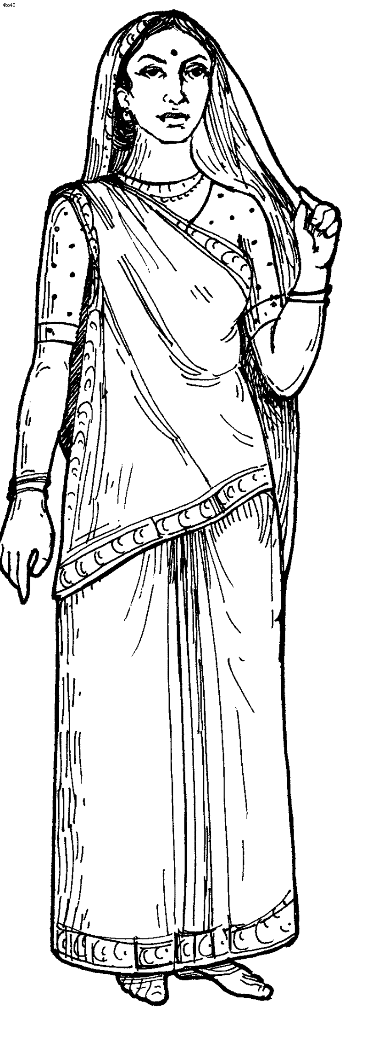
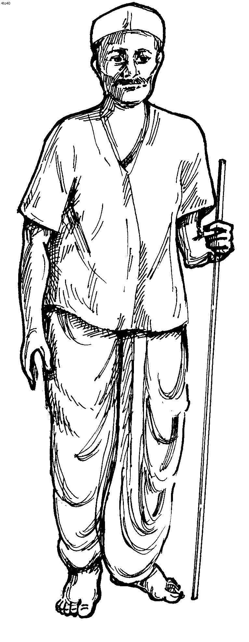


Preferences
I prefer serials over reality shows
TV Program | category | genre | duration
1 | Reality show | Comedy | 1hr
2 | Reality show | Dance | 30 min
3 | Serial | War | 30 min
4 | Movie | Action | 3hr
I like movies more than serials
Short duration is better for me
I prefer dance than comedy

Slide 5
Uncertain Preferences
Probability that I prefer serials over reality shows is 0.6
TV Program | category | genre | duration
1 | Reality show | Comedy | 1hr
2 | Reality show | Dance | 30 min
3 | Serial | War | 30 min
4 | Movie | Action | 3hr
Probability that I like movies more than serials 0.5
Probabity that I prefer Short duration is 0.4
Probability that I prefer dance than comedy is 0.7
Notes:
Here you should say that each object has set of attributes and there is pair wise probability b/w every pair of attribute values. These probability values can be extracted from user h

Slide 6
Skyline Probability
It is the probability that a given object O is a skyline object, given preference probabilities of an individual attributes.
Preference relation can be a valid dominance relation and it is possible that in a database the preferences of data points are uncertain.
Our focus is on computing skyline probability over uncertain preferences.
Given two distinct attribute values a and b, the probabilistic model to describe uncertain preferences is given as: Pr(a≺ b)+Pr(b≺ a)<1

Slide 7
Skyline Probability
Applications :
Recommendation to the TV channel owner to increase TRP ratings based on locality.
Personalized recommendation based on past preferences.
Group recommendation based on group history of preferences.

Slide 8
How to compute?
Example:
Objects | A | B
O | a1 | b1
Q¹ | a3 | b3
Q² | a1 | b3
Q³ | a2 | b2
Q⁴ | a3 | b1

Slide 9

How to compute
Example:
Objects | A | B
O | a1 | b1
Q¹ | a3 | b3
Q² | a1 | b3
Q³ | a2 | b2
Q⁴ | a3 | b1
$$\text{sky}\text{(}\text{O}\text{) = 1+∑}\text{n}\text{k}\text{=1 (−1}\text{)}\text{k} \text{∑}\text{J}\text{∊2}\text{θ}\text{, |}\text{J}\text{|}\text{=}\text{k} \text{Pr}\text{(}\text{EJ}\text{)}$$
Let Pr(a1≺a2)=Pr(a2≺a1)=Pr(a1≺a3)=Pr(a3≺a1)=0.5
Pr(b1≺b2)=Pr(b2≺b1)=Pr(b1≺b3)=Pr(b3≺b1)=0.5
1234
123
124
134
234
Pr(a2≺a1) × Pr(a3≺a1) × Pr(b2≺b1) = 0.125
12
13
14
23
24
34
1
2
3
4
Pr(a3≺a1) × Pr(b3≺b1) = 0.25
Notes:
Probabilty that O is a skyline object is one minus probability that other objects are preferred to O.
To findout the probability that other objects preferred to O, we should find out all the joint probabilities and use
Inclusion exclusion principle to get whole probability.

Slide 10
How to compute
Example:
Objects | A | B
O | a1 | b1
Q¹ | a3 | b3
Q² | a1 | b3
Q³ | a2 | b2
Q⁴ | a3 | b1
$$\text{sky}\text{(}\text{O}\text{) = 1+∑}\text{n}\text{k}\text{=1 (−1}\text{)}\text{k} \text{∑}\text{J}\text{∊2}\text{θ}\text{, |}\text{J}\text{|}\text{=}\text{k} \text{Pr}\text{(}\text{EJ}\text{)}$$
= 1 - 0.5
+ 0.0625
- 0.4375
+ 0.0625
= 0.1875
1234
0.0625
123
124
134
234
0.4375
12
13
14
23
24
34
0.0625
1
2
3
4
0.5
Complexity: O(d.2^{n})
Let Pr(a1≺a2)=Pr(a2≺a1)=Pr(a1≺a3)=Pr(a3≺a1)=0.5
Pr(b1≺b2)=Pr(b2≺b1)=Pr(b1≺b3)=Pr(b3≺b1)=0.5

Slide 11
Proposed heuristic

Slide 12
Zero Contributing Set
Example:
Objects | A | B
O | a1 | b1
Q¹ | a3 | b3
Q² | a1 | b3
Q³ | a2 | b2
Q⁴ | a3 | b1
Zero Contributing set
Attributes other than O’s attributes:
{a2, a3; b2, b3}
1234
123
124
134
234
12
13
14
23
24
34
1
2
3
4
Attributes other than O’s attributes:
{a2, a3; b2, b3}
Pr(13) = Pr(123) = Pr(134) = Pr(1234) = 0.0625
Notes:
Explain what is 1, 13 and so on. For example 13 is the probability that Q1^Q3 prefered to O.

Slide 13
Algorithm Demonstration
Working Example :
Object | A | B | C | D
O | a1 | b1 | c1 | d1
Q¹ | a2 | b2 | c1 | d1
Q² | a1 | b1 | c2 | d2
Q³ | a1 | b2 | c2 | d1
Q⁴ | a1 | b2 | c1 | d2
Q⁵ | a1 | b1 | c1 | d2

Slide 14

Algorithm
{a2; b2; c2; d2}
12345
Obj | A | B | C | D
O | a1 | b1 | c1 | d1
Q¹ | a2 | b2 | c1 | d1
Q² | a1 | b1 | c2 | d2
Q³ | a1 | b2 | c2 | d1
Q⁴ | a1 | b2 | c1 | d2
Q⁵ | a1 | b1 | c1 | d2
Suplist → {12345}
Minlist → {1,2, 3, 4, 5}
delList → { }
{a2; b2}
{c2; d2}
{b2; c2}
{b2; d2}
{d2}
1
2
3
4
5

Slide 15
Algorithm
{a2; b2; c2; d2}
12345
Obj | A | B | C | D
O | a1 | b1 | c1 | d1
Q¹ | a2 | b2 | c1 | d1
Q² | a1 | b1 | c2 | d2
Q³ | a1 | b2 | c2 | d2
Q⁴ | a1 | b2 | c1 | d2
Q⁵ | a1 | b1 | c1 | d2
1345
2345
Suplist → {12345}
Minlist → {12, 13, 14, 15, 23, 24, 25, 34, 35, 45}
delList → { }
final = {1,2, 3, 4, 5}
12
13
14
15
23
24
..
{a2; b2; c2; d2}
1
2
3
4
5

Slide 16
Algorithm
Superset of 345 is exist in suplist, so don’t add 345 to suplist.
Obj | A | B | C | D
O | a1 | b1 | c1 | d1
Q¹ | a2 | b2 | c1 | d1
Q² | a1 | b1 | c2 | d2
Q³ | a1 | b2 | c2 | d1
Q⁴ | a1 | b2 | c1 | d2
Q⁵ | a1 | b1 | c1 | d2
{a2; b2; c2; d2}
1345
2345
145
345
Suplist → {1345, 2345}
Minlist → {13, 14, 15, 23, 24, 25, 34, 35, 45}
delList → {[12, 12345] }
final = {1,2, 3, 4, 5}
13
14
15
23
24
..
{a2; b2; c2; d2}
1
2
3
4
5

Slide 17
Algorithm
15 and 45 are in minlist, do not add it to suplist
Obj | A | B | C | D
O | a1 | b1 | c1 | d1
Q¹ | a2 | b2 | c1 | d1
Q² | a1 | b1 | c2 | d2
Q³ | a1 | b2 | c2 | d1
Q⁴ | a1 | b2 | c1 | d2
Q⁵ | a1 | b1 | c1 | d2
2345
{a2; b2; d2}
145
Suplist → {2345, 145}
Minlist → {14, 15, 23, 24, 25, 34, 35, 45}
delList → {[12, 12345], [13, 1345] }
final = {1,2, 3, 4, 5}
14
15
23
24
.. 45
{a2; b2; d2}
1
2
3
4
5

Slide 18
Algorithm
At the end of second level
Obj | A | B | C | D
O | a1 | b1 | c1 | d1
Q¹ | a2 | b2 | c1 | d1
Q² | a1 | b1 | c2 | d2
Q³ | a1 | b2 | c2 | d1
Q⁴ | a1 | b2 | c1 | d2
Q⁵ | a1 | b1 | c1 | d2
Number of residual terms = 9
Total number of terms = 31
Suplist → {}
Minlist → {}
delList → {[12, 12345], [13, 1345], [14, 145], [23, 2345], 24, 245], [34, 345] }
final = {1,2, 3, 4, 5, 15, 25, 35, 45}
15
25
35
45
1
2
3
4
5

Slide 19
Experimental Results
To evaluate the effectiveness and efficiency of our proposed algorithms, we carried out experiments using both real and synthetic datasets.
Synthetic Dataset(25 objects, dim in range of [2,8]): randomly generated with uniform distribution for each dimension and assuming mutual independence.
Lenses Dataset(24 objects): Number of terms needed for computation by using ZYLZ algorithm is 2²³ = 8388608
Number of terms needed for computation by using our algorithm is 36339 which is 0.04% of 8388608 which is 99.96% reduction in number of terms needed for computation by using our algorithm.

Slide 20
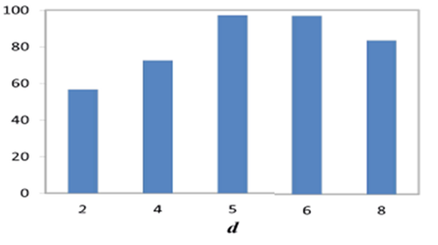
Experimental Results Summarization
Dataset | n | d | %reduction in no. of terms | Termination Level
Lenses | 24 | 5 | 91.52-99.56 | 15-20
Synthetic | 25 | 5 | 92.93-99.99 | 10-20
Table: Efficiency of our algorithm over number of terms and termination level
% reduction in number of terms
Fig: % reduction in number of terms by varying d

Slide 21
Conclusions and Future work
We propose new algorithm for the computation of skyline probability over uncertain preferences.
The algorithm implicitly enumerates the terms which vanish while computing joint probability. These terms when ignored results in substantial saving of computational efforts.
Our algorithm uses much fewer terms and hence takes less time.
Using absorption as a preprocessing step[Zhang et.al] to our algorithm is part of future work.

Slide 22
References
Zhang, Q., Ye, P., Lin, X., Zhang, Y.: Skyline probability over uncertain preferences. In: EDBT/ICDT, pp. 395–405 (2013)
Atallah, M.J., Qi, Y., Yuan, H.: Asymptotically efficient algorithms for skyline probabilities of uncertain data. ACM Trans. Database Syst. 36(2), 12 (2011)
B¨orzs¨onyi, S., Kossmann, D., Stocker, K.: The skyline operator. In: ICDE, pp. 421–430 (2001)
Pei, J., Jiang, B., Lin, X., Yuan, Y.: Probabilistic skylines on uncertain data. VLDB, 15–26 (2007)

Slide 23
Thank you

