Slide 1

Energy Efficient Sweep Coverage with Mobile and Static Sensors
Barun Gorain and Partha Sarathi Mandal
Department of Mathematics
Indian Institute of Technology Guwahati, India

Slide 2
Outline
Introduction
Problem Definitions
Complexity Results
Algorithm
Analysis
A Special Case
Conclusion

Slide 3
Introduction
Coverage is a very important issue in wireless sensor networks(WSNs) and is defined as quality of surveillance of the sensing function in WSNs.
To collect complete information from a region, it is necessary the region is completely covered by the sensor nodes.

Slide 4
Point Coverage

Slide 5
Area Coverage

Slide 6
Barrier Coverage
USA
MEXICO

Slide 7
Sweep Coverage
In coverage problem a continuous monitoring of the target field is required by the sensor nodes whereas in sweep coverage, periodic monitoring is sufficient.
Small number of mobile sensor nodes can guarantee sweep coverage with a given time period.

Slide 8
Coverage
X
X
X
X
X
X
X
X
X

Slide 9
Sweep Coverage
X
X
X
X
X
X
X
X
X

Slide 10
Sweep Coverage
Sweep Coverage: [1,2,3]
Let U = {u₁,u₂,…,u_{n}} be a set of points on a two dimensional plane and S = {s₁,s₂,…s_{m}} be a set of mobile sensor nodes. A point u_{i} is said to be t-sweep covered if and only if at least one mobile sensor node visits u_{i} within every t time period.
The set U is said to be globally sweep covered by the mobile sensor nodes of S if all u_{i} are t sweep covered.
The time period t is called the sweep period of the points in U.
1. “Sweep coverage with mobile sensors”, Mo Li, Wei-Fang Cheng, Kebin Liu, Yunhao Liu, Xiang-Yang Li, and Xiangke Liao, IEEE Trans. Mob. Comput., 10(11):1534–1545, 2011.”
2.“Point and area sweep coverage in wireless sensor networks ”,Barun Gorain and Partha Sarathi Mandal , Wiopt 2013.
3. .“brief announcement: :sweep coverage with static and mobile sensors ”,Barun Gorain and Partha Sarathi Mandal , SSS 2014.

Slide 11
Sweep Coverage Problem
The sweep coverage problem is to find minimum number of mobile sensors to guarantee t-sweep coverage for all the points.
The sweep coverage problem is NP-hard and cannot be approximated within a factor of 2 unless P=NP [Li et al 2011].

Slide 12
Motivation
Instead of using only mobile sensors, combination of static and mobile sensors can be more energy efficient.
Example:
M
M

Slide 13
Motivation
Instead of using only mobile sensors, combination of static and mobile sensors can be more energy efficient.
Example:
M
S

Slide 14
Gsweep coverage
For a given set of points U and a set of sensors
(combination of mobile and static), a point u_{i} is said to be t-Gsweep covered iff one of the following two conditions happens:
At least one mobile sensor visits u_{i} in every t time periods
A static sensor is deployed at u_{i} which periodically covers u_{i}.

Slide 15
Problem Definition
(EEGSweep Coverage Problem).
Let U = {u₁, u₂, · · · , u_{n}} be a set of PoIs, S = {s₁, s₂, …, s_{p}} be a set of static sensors and M ={m₁,m₂, · · · ,m_{q}} be a set of mobile sensors. Let v be the uniform speed of the mobile sensors and λ, μ be the energy consumptions in every unit time for a static sensor and mobile sensor, respectively. Find X ≤ p and Y ≤ q, such that using X static sensors and Y mobile sensors, t-GSweep coverage for every PoI in U can be guaranteed and λ X + μY is minimized.

Slide 16
Complexity Results
Theorem : EEGSweep Coverage problem is NP-hard and cannot be approximated within a factor of 2 unless P=NP.
Proof: Sweep coverage problem is NP-hard and cannot be approximated within a factor of 2 unless P=NP [1].
Sweep coverage problem [1] is a special case of
EEGSweep Coverage problem for λ= μ.

Slide 17
Preliminaries
k-mst Problem: Let G = (V,E,w) be a weighed graph, where the edge weights are positive real number and k be a given positive integer. Find a minimum weighted tree of G that spans any k vertices of G.
k-tsp Problem: Let G = (V,E,w) be a weighed graph, where the edge weights are positive real number and k be a given positive integer. Find a minimum weighted tour of G visiting any k vertices of G.
Garg in [4] proposed 2 factor approximation algorithm for both of the problems
[4]Naveen Garg. Saving an epsilon: a 2-approximation for the k-mst problem in graphs. In Harold N. Gabow and Ronald Fagin, editors, Proceedings of the 37th Annual ACM Symposium on Theory of Computing, Baltimore, MD, USA, May 22-24, 2005, pages 396–402. ACM, 2005.

Slide 18
Preliminaries
G =(V,E,w)is the corresponding complete graph with the point set U.
w(u_{i},u_{j})= Euclidean distance between u_{i},u_{j}.
G’=(V,E,w’), where
w’(u_{i},u_{j})=1 if w(u_{i},u_{j}) >vt
= w(u_{i},u_{j})/vt, otherwise

Slide 19
Preliminaries
MST_{k}^{G’} → k-mst found by 2 factor approximation algorithm on G’.
MST_{k}^{G} → Corresponding tree on G
mst_{k}^{opt} → optimal k-mst on G’
X_{opt}, Y_{opt} → number of static and mobile sensors in the optimal solution
K_{opt} → number of vertices visited by Y_{opt} mobile sensors in the optimal solution

Slide 20
Algorithm: Idea
1. For k=1 to n, find a k-mst on G’.
2. Delete all the edges from the k-mst in G with weight more than vt. Let C₁,C₂, … ,C_{m} be the connected components.
3. Find tour T₁, T₂, …, T_{m} after doubling and short cutting.
4. Partition each tour T_{i} into parts with weight at most vt.
5. Deploy one mobile sensor at each of the partition points.
6. Deploy static sensors at each of the n-k points which are not part of the k-mst.

Slide 21
Partition and movement along a tour
vt

Slide 22
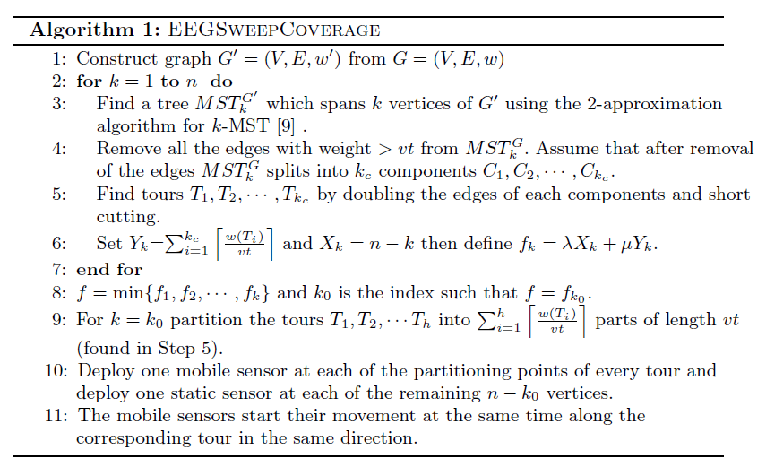
Algorithm

Slide 23
Analysis
Theorem 2. Algorithm 1 ensures t-GSweep coverage for each of the PoIs.

Slide 24
Analysis
Lemma 1. ⌈w’(mst_{opt} ^{kopt} )⌉ ≤ 2Y_{opt}
proof:
Let P₁, P₂, … , P_{Yopt} be the movement paths of the Y_{opt} mobile sensors in some time interval
[t₀,t+t₀].
Then w(P_{i})≤ vt and w’(P_{i}) ≤ 1.
Therefore ∑ w’(P_{i}) ≤ Y_{opt}

Slide 25
Proof(Cont..)
…………………..
P₁
P₂
P_{Yopt}

Slide 26
Proof(Cont..)
…………………..
P₁
P₂
P_{Yopt}
The tree H’ spans k_{opt} vertices of G’.

Slide 27
Proof(Cont..)
Therefore, w’(mst_{opt} ^{k}opt ) ≤ w’(H’) < 2Y_{opt}
⌈w’(mst_{opt} ^{kopt} )⌉ ≤ 2Y_{opt}

Slide 28
Analysis
Theorem 3. The approximation factor of the Algorithm 1 is 8.
Proof:
The Algorithm 1 finds tree MST_{kopt}^{G’} for the iteration k = k_{opt} using 2-approximation algorithm of k-MST [9] on G’.
Therefore, w’(MST_{kopt}^{G’}) ≤ 2 w’(mst_{opt} ^{k}opt )

Slide 29
Proof(Cont..)
Let there are m edges in MST_{kopt}^{G} with weight >vt.
After deleting these m edges let C₁, C₂, …, C_{m+1} be the connected components.
Let T₁, T₂, …, T_{m+1} be the tours computed after doubling the edges and short cutting

Slide 30
Proof(Cont..)
Number of mobile sensors
Y_{kopt}= ∑⌈w(T_{i})/vt⌉ ≤ 2 ∑w(C_{i})/vt +(m+1)
≤2 ∑w(C_{i})/vt +2m
Also, w’(MST_{kopt}^{G’}) =∑w(C_{i})/vt +m
Therefore, Ykopt ≤2w’(MST_{kopt}^{G’}) ≤4w’(mst_{opt} ^{k}opt )
≤ 8Y_{opt}

Slide 31
Proof(Cont..)
If m=0, then
Y_{kopt}= ⌈2w’(MST_{kopt}^{G’})/vt⌉
≤ 4⌈ w’(mst_{opt} ^{k}opt ) ⌉
≤ 8Yopt
Therefore,
λ X_{kopt}+μY_{kopt} ≤ λX_{opt} + 8 μ Y_{opt} ≤ 8(λX_{opt} + μ Y_{opt})
Hence, the algorithm is a 8 factor approximation algorithm.

Slide 32
A special case
Definition 5 (SEEGSweep Coverage Problem). Let U = {u₁, u₂, · · · , u_{n}} be a set of PoIs, S = {s₁, s₂, · · · , s_{p}} be a set of static sensors and M = {m₁,m₂, · · · ,m_{q}} be a set of mobile sensors. Let v be the uniform speed of the mobile sensors and λ and μ be the energy consumption in every unit of time for a static sensor and mobile sensor, respectively. Find X and Y , such that
1. X static sensors and Y mobile sensors guarantee t-GSweep coverage of all the PoIs.
2. The mobile sensors visit the same set of PoIs
3. λ X + μY is minimum.
This special case of EEGSweep coverage problem is also NP-hard and cannot be approximated within a factor of 2 unless P=NP.

Slide 33
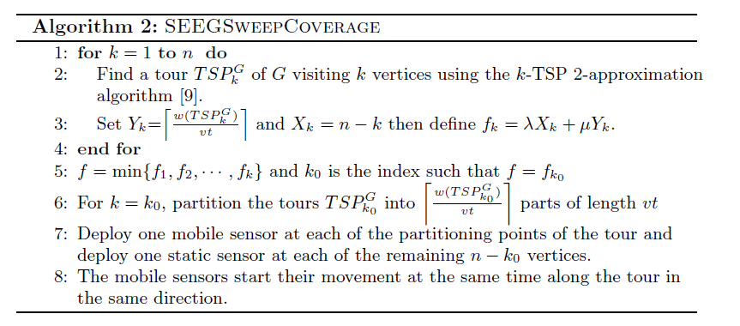
Algorithm

Slide 34
Analysis
The Algorithm 2 is a 2 factor approximation algorithm.
Proof:
Let X_{opt} and Y_{opt} be the number of static and mobile sensors in the optimal solution.
Then Y_{opt} mobile sensors visits k_{opt}=n-X_{opt} vertices of the graph.

Slide 35
Analysis
tsp^{kopt}_{opt} be the minimum tsp tour covering kopt vertices.
TSPG_{kopt} be the tsp tour computed by 2 factor approximation algorithm.
Then, w₁(TSPG_{kopt} )≤ 2w₁(tsp^{kopt}_{opt} )
Since all mobile sensors visited all k_{opt} vertices,
Y_{opt} ≥w₁(tsp^{kopt}_{opt} )/vt

Slide 36
Analysis
Number of mobile sensors calculated by our algorithm, Y ≤ w(TSPG_{kopt} )/vt
≤2 w(tsp^{kopt}_{opt} )/vt ≤ 2Y_{opt}
Therefore, total energy consumption
λX_{kopt} +μY_{kopt} ≤ λX_{opt}+ 2μY_{opt} ≤ 2(λX_{opt}+ μY_{opt}).
Therefore, the algorithm is a 2 factor approximation algorithm.

Slide 37
Conclusion
In this paper we have proposed an energy efficient sweep coverage problem.
We have proposed an 8-approximation algorithm to solve the problem.
Another solution for a special case of this problem is proposed, which achieves the best possible approximation factor 2.
The sweep coverage in presence of obstacles might be a interesting problem to investigate in future.

Slide 38
THANK YOU

