Slide 1



Auction/Belief propagation algorithms for constrained assignment problems
M. Yuan, W. Shen, J. Li, Y. Pavlidis and S. Li
Walmart Labs and University of Illinois

Slide 2
The problem
 | Category1 |  | Category2
 | Item1 | Item2 | Item3 | Item4 | Item5
Customer1 | 0.12 | 0.37 | 0.12 | 0.89 | 0.76
Customer2 | 0.98 | 0.54 | 0.98 | 0.45 | 0.53
Customer3 | 0.12 | 0.65 | 0.12 | 0.65 | 0.12
Customer4 | 0.98 | 0.74 | 0.95 | 0.12 | 0.87
Customer5 | 0.35 | 0.42 | 0.65 | 0.45 | 0.52

Slide 3
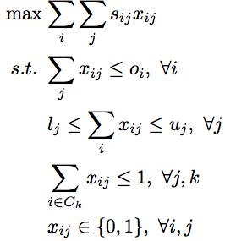
It is integer programming
Generally, integer programming is hard, let alone size of the problem (almost 0.6 giga variables in our case!)

Slide 4
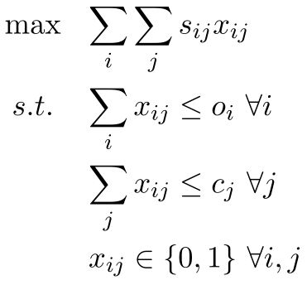
The basic problem

Slide 5
Solving the problem
Integer programming
Minimum cost flow (Graph)
Auction algorithm (Bipartite graph)
All the above can reach the optimum

Slide 6
Minimum Cost Flow
_{-Score/1}
5
2
_{0/5}
_{0/2}
5
S
_{0/4}
4
T
_{0/3}
5
3
5
_{0/Inf}

Slide 7
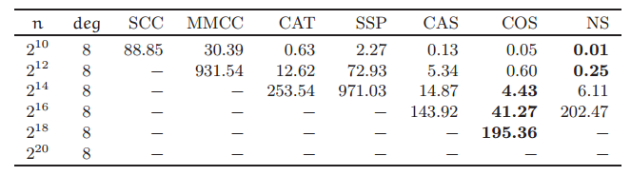
Scalability
Source:
Efficient implementations of minimum-cost flow algorithms
Z. Király, P. Kovács

Slide 8
Auction
[bids], price
Offers
Customers
Baskets
_{[O3,O2]}
_{[O1,O3]}
₈
2
_{[(5,C1)], 5}
_{[O3]}
1
_{[(9,C2)], 9}
₁₀
₅
₃
₁
1
_{[O1]}
3
_{[(3,C1), (),()], 0}
₁
₆
2
_{[(3,C1), ()], 0}

Slide 9
Algorithm high-level description (1)
The algorithm views the assignment process as an auction game. Customers take turns to bid their favorite offers based on the corresponding scores (values). The offers then have prices from the bids they received. As the auction proceeds, the customers adjust their favorite offers according to the current offer values.

Slide 10
Algorithm high-level description (2)
This is an iterative algorithm. In each iteration, a customer computes her current best offers. The current value of an offer to a customer is defined as the difference of that customer’s score to the offer and the price of the offer. She then orders them and starts bidding through from the best one.

Slide 11
Adding more constraints
It is even not obvious to come up with a feasible solution after adding a lower bound.
It is also hard to determine the termination of the algorithm, since the customer may bid offers with negative values.
Need to redesign the bidding strategies.

Slide 12
Implementation tips
Use arrays to store the scores
  Compress a sparse matrix
Use heaps to track the offer assignments
  Store the bids each offer received
  Find the smallest bid faster

Slide 13
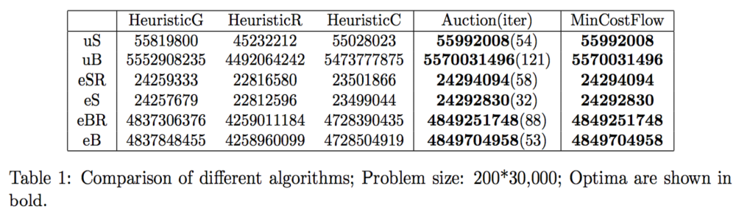
Evaluation: correctness
Evaluated the algorithms with synthetic scores
Problem size: 200*30,000

Slide 14
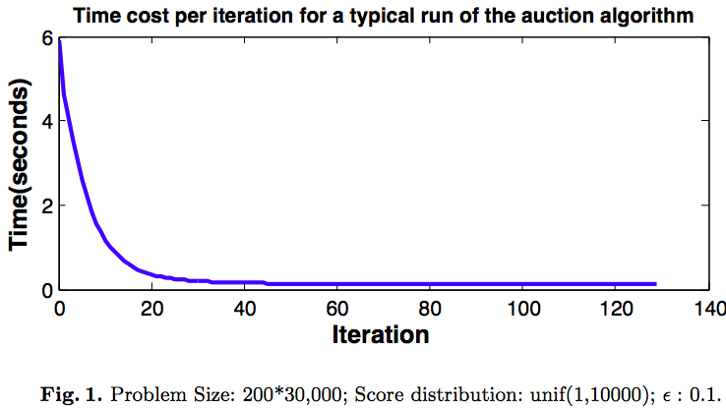
Evaluation: convergence

Slide 15
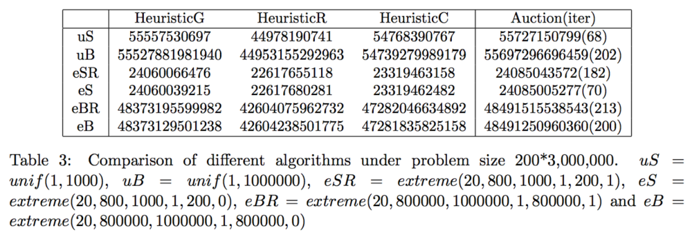
Evaluation: scalability
Problem size: 200*3,000,000

Slide 16
THANK YOU
Questions?
Email us myuan@walmartlabs.com

