Slide 1
CALDAM STEERING COMMITTEE
Joseph Cheriyan, University of Waterloo, Canada
Subir Kumar Ghosh (Chair), TIFR , India
Janos Pach, EPFL, Lausanne, Switzerland
Nicola Santoro, Carleton University, Canada
Swami Sarvattomananda, RKMV University, India
Peter Widmayer, ITCS, ETH Zürich, Switzerland
Emo Welz, ITCS, ETH Zürich, Switzerland.
Chee Yap, Courant Institute of Mathematical Sciences, New York University, USA.

Slide 2

CALDAM 2016
Conference on Algorithms and Discrete Applied Mathematics
February 18-20, 2016
University of Kerala, Trivandrum
Manoj Changat (Conference Chair)
Anil Maheshwari (PC Co-Chair)
Sathish Govindarajan (PC Co-Chair)

Slide 3
STRUCTURE of CALDAM 2016
Two to three invited speakers
Contributed talks (about 25-30)
Springer LNCS like CALDAM 2015
Special Issue of DAM like CALDAM 2015
Business Meetings and Cultural Programs

Slide 4

One of the first 16 Universities in India
Founded as the University of Travancore in the erstwhile princely state of Travancore in 1937.
16 Faculties & 41 Departments
180 Professors & around 2000 students
University has over 150 affiliated colleges

Slide 5
Thiruvananthapuram (Trivandrum)
Capital city of Kerala
Occupy an important place in ancient tradition
Folklores and literature of the State of Kerala
Had a political and cultural history in the early past
Pleasant Climate (Max. Temp .about 28-30 degrees in Feb)
International Airport- well connected to other cities in India

Slide 6

Tourist Attractions
Trivandrum district holds a number of tourist spots
Hill stations: Ponmudi
Beaches : Shanghumugham, Kovalam, Varkala, Aazhimala
Lagoons : Veli, Poovar
Wild life sanctuaries : Peppara, Agastyakoodam
Ayurveda centres and massages

Slide 7
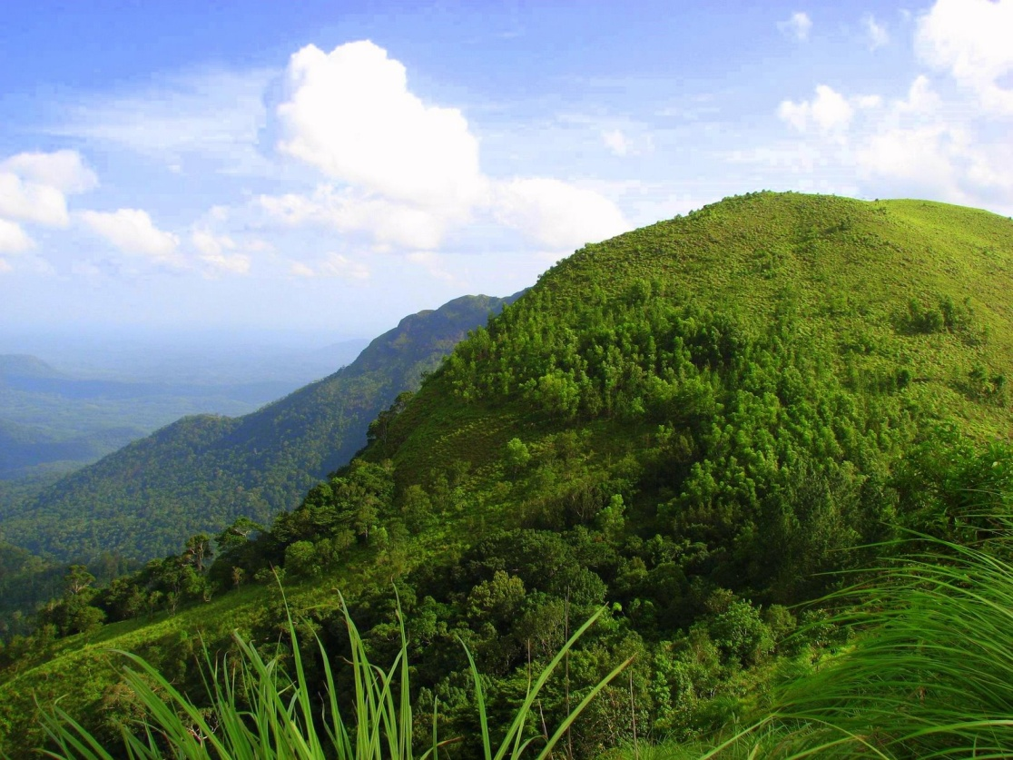
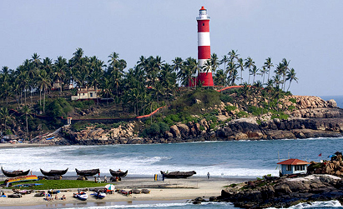
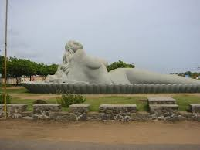
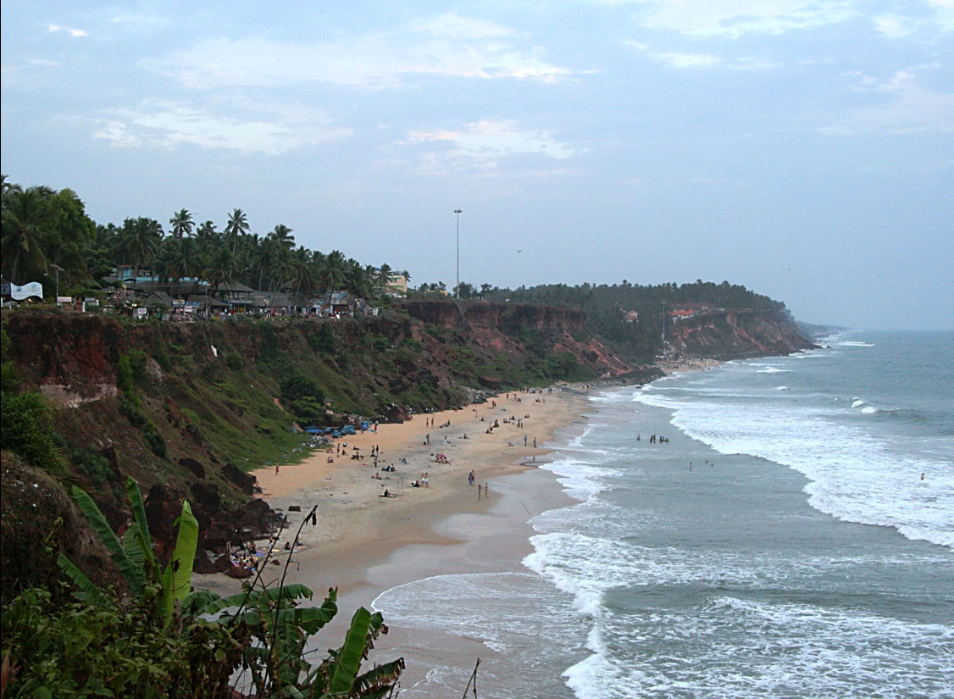
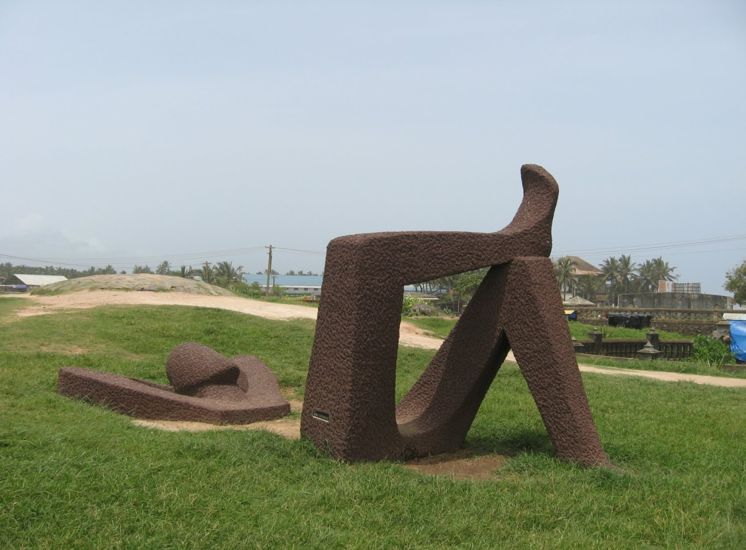

Slide 8
Temples
Sree-Padmanabhaswami Temple
Attukal Devi Temple
Pazhavangadi Ganapathi Temple
Karikkakam Chamundi Temple

Slide 9
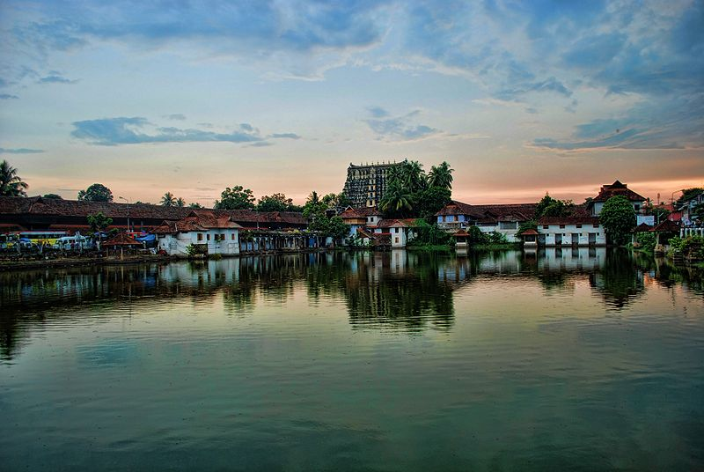
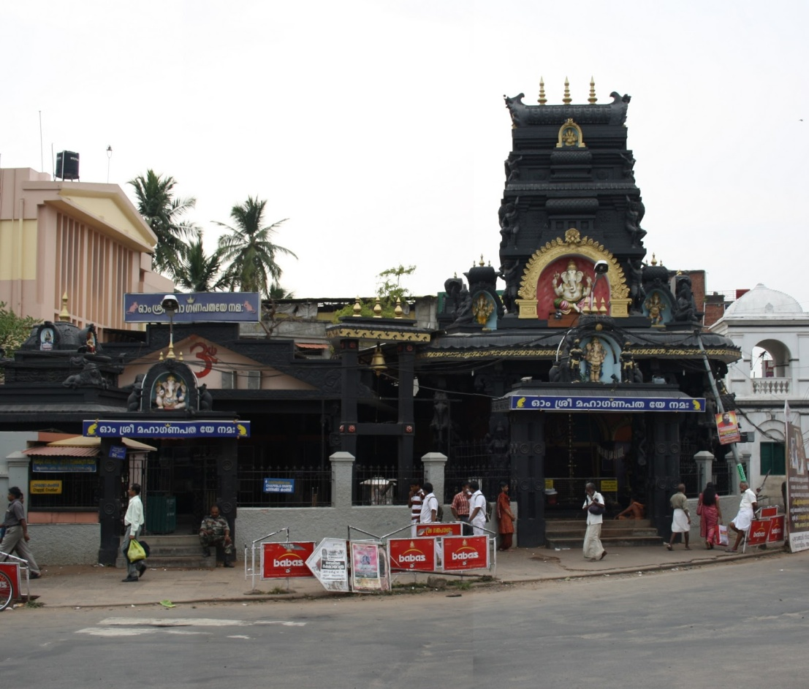
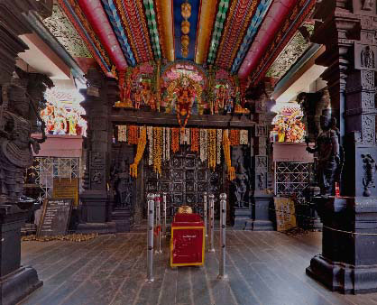
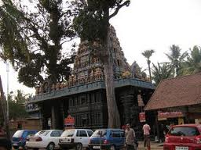

Slide 10
Kanyakumari
90 Kms from Trivandrum
Three oceans meet (Indian Ocean, Bay of Bengal and Arabian sea)
Vivekananda Rock
Gandhi Smrithi Mandapam
Both sun rise and sunset views (One of the two places in the world where one can see both sunrise and sunset )
Padmanbhapuram Palace and Museum ( on the way to Kanyakumari from Trivandrum)
A day trip on 17th Feb can be arranged

Slide 11
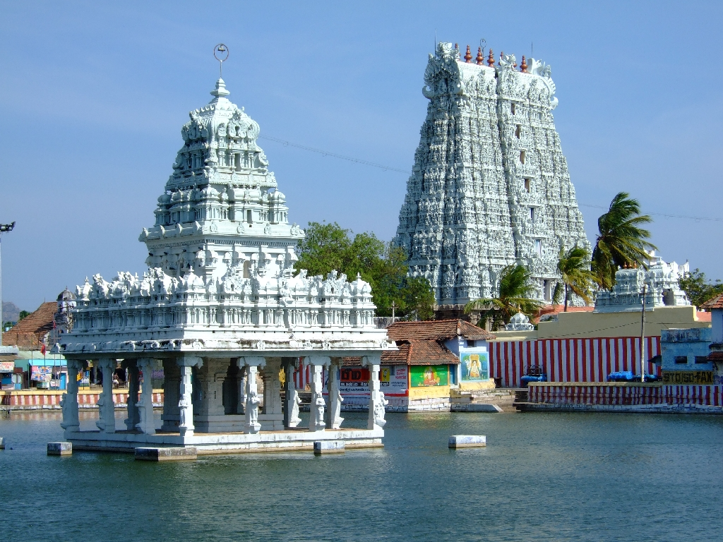
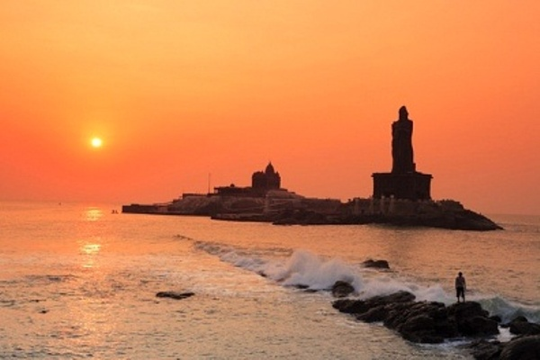
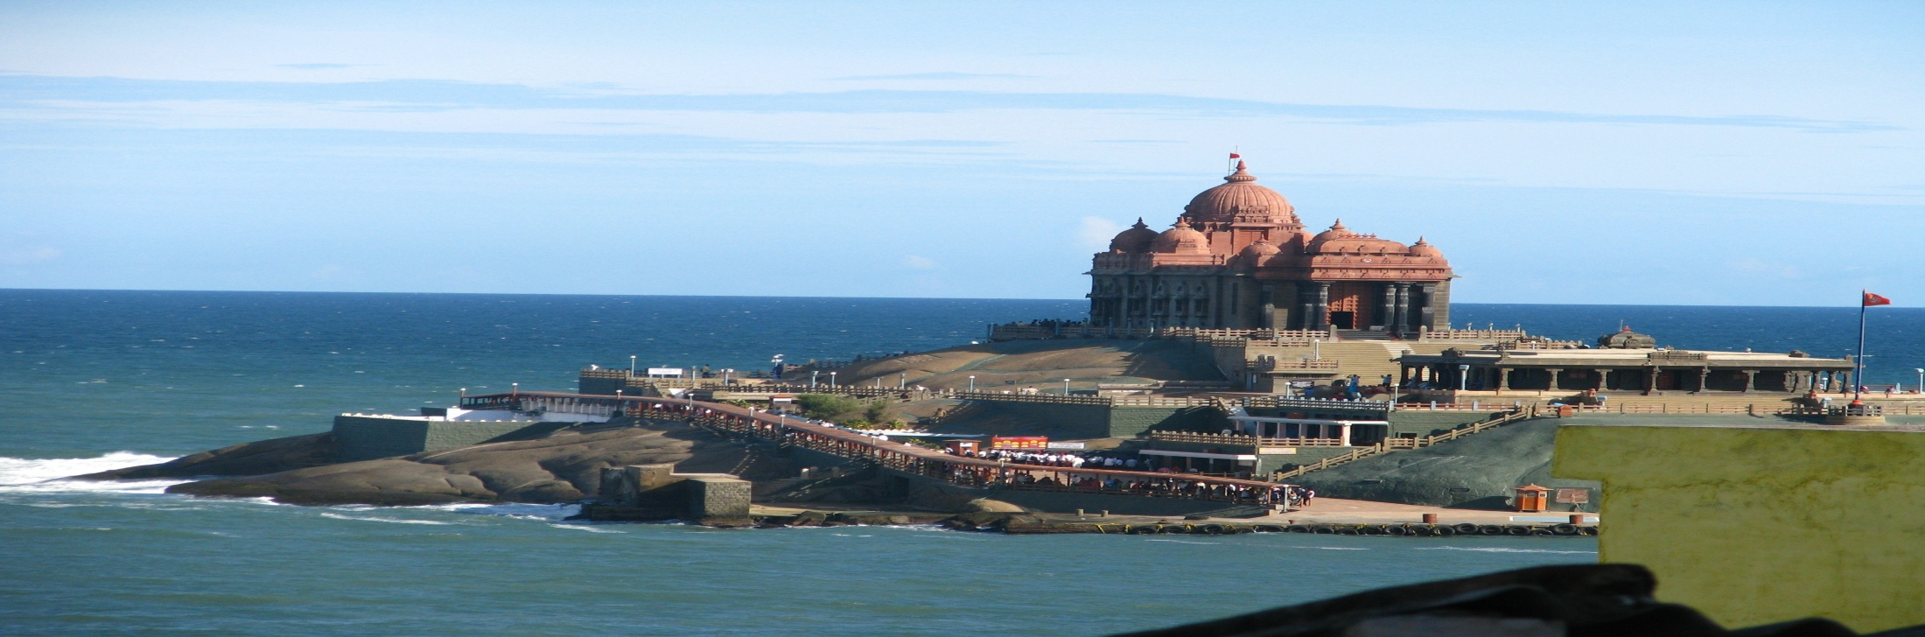

Slide 12
Pre-Conference School
Pre-School on Discrete Applied Mathematics & Indo-Hungarian School on Discrete Applied Mathematics
15-16, February, 2016
University of Kerala & Tata Institute of Fundamental Research
Manoj Changat (Co-Convenor)
Subir Kumar Ghosh (Co-Convenor)
Gyula Katona (Co-Convenor)

Slide 13
Pre-Conference School
About 12 speakers, 6 Indian speakers and 6 speakers from the respective country
Around 40 participants consisting of Ph.D students and Faculty members from all over India

Slide 14
Previous Schools
Indo-Israli School on Graph & Geometric Algorithms &
Pre-Workshop School of WALCOM 2013 on Graph and Geometric Algorithms, ISI Kolkata and RKMVU Belur, February 11-13, 2013.
Indo-Swiss School on Algorithms and Combinatorics &
Pre-Workshop School of WALCOM 2014 on Algorithms and Combinatorics, IIT Madras, February 10-11, 2014.
Indo-Czech Republic School on Discrete Mathematics &
Pre-Conference School of CALDAM 2015 on Discrete Mathematics, IIT Kanpur, February 5-6, 2015.

Slide 15
See you at CALDAM 2016

