Slide 1
Algebraic Expressions of Rhomboidal Graphs
MARK KORENBLIT
Department of Computer Science
Holon Institute of Technology
Israel
Conference on Algorithms and Discrete Applied Mathematics CALDAM 2015
February 8-10, 2015
Indian Institute of Technology, Kanpur

Slide 2
We investigate relationship between algebraic expressions and two- terminal directed acyclic graphs
(st-dags) and estimate the length of the shortest expression.

Slide 3
The Goal:
Efficient computation on a graph
What is an efficient computation?

Slide 4
ab + ac + ad
Is it an efficient computation?
No!!!
Why?
a(b + c + d)

Slide 5
Relationship between Graphs and Algebraic Expressions
b
b
a
a
c
a
c
a
d
d
ab + ac + ad
= a(b + c + d)

Slide 6
Relationship between Graphs and Algebraic Expressions
b
b
a
c
a
c
d
d
a (b + c + d)
a(b + c + d)

Slide 7
A two-terminal directed acyclic graph (st-dag) has only one source s and only one sink t.
We consider a labeled graph in which each edge has a unique label.
We define the sum of edge label products corresponding to all possible paths between the source and the sink of the st-dag G as the canonical expression of G. An algebraic expression is called an st-dag expression if it is algebraically equivalent to the canonical expression of an st-dag. This expression consists of edge labels, the operators + (disjoint union) and ⋅ (concatenation, also denoted by juxtaposition when no ambiguity arises), and parenthesis.

Slide 8
We define the total number of labels in an algebraic expression, as the complexity of the algebraic expression.
An optimal representation of the algebraic expression F is an expression of the minimum complexity algebraically equivalent to F.
We consider expressions with a minimum (or, at least, a polynomial) complexity as a key to generating efficient algorithms on distributed systems.

Slide 9
Examples of St-dag Expressions
3
6
b
d
f
h
i
1
8
4
7
a
c
e
g
2
5
Canonical expression:
acegi + acfhi + bdegi + bdfhi
(aceg + acfh + bdeg + bdfh)i
a(cegi + cfhi)+b(degi + dfhi)
Optimal representation:
(ac + bd)(eg + fh)i

Slide 10
St-dag Expressions of Series-Parallel Graphs
3
6
b
d
f
h
i
1
8
4
7
a
c
e
g
2
5
Optimal representation:
(ac + bd)(eg + fh)i
An expression of a series-parallel graph (obtained by a series or a parallel composition of series- parallel graphs) has a representation in which each label appears only once (read-once formula).

Slide 11
An st-dag is series-parallel (SP) if and only if it does not contain a subgraph homeomorphic to the forbidden graph.
b
The forbidden graph:
c
e
a
d
Possible optimal representations:
a (ce + d) + be (ac + b)e + ad
An expression of a homeomorph of the forbidden subgraph belonging to any non-SP st-dag has no representation in which each label appears once.
For this reason, an expression of a non-SP st-dag cannot be represented as a read-once formula.
For arbitrary functions, which are not read-once, generating the optimum factored form is NP-complete.
Therefore, generating an optimal representation for a non-SP st-dag expression is a highly complex problem.

Slide 12
We consider rhomboidal digraphs which are examples of non-series-parallel graphs.
Our intention is to generate and to simplify expressions of rhomboidal digraphs.
With that end in view, we consider decomposition methods.

Slide 13
Rhomboid
(Consecutive series compositions of rhomb st-dags)
1
2
n-1
e₁
e₂
e_{2n}
2
1
n
d₂
d_{2n}
d₁
1
2
n-1
The set of vertices of N-vertex rhomboid
(N-1)/3 upper vertices
(N+2)/3 middle (basic) vertices (n – size of rhomboid)
(N-1)/3 lower vertices

Slide 14
Square Rhomboid (SR)
(A planar approximation of the square of the rhomboid)
1
c₁
2
c_{n-2}
n-1
e₁
e₂
e_{2n}
b₁
2
b_{n-1}
1
n
d₂
d_{2n}
d₁
1
a₁
2
a_{n-2}
n-1
The set of vertices of N-vertex SR
(N-1)/3 upper vertices
(N+2)/3 middle (basic) vertices (n – size of SR)
(N-1)/3 lower vertices

Slide 15
Full Square Rhomboid (FSR)
(The square of the rhomboid)
1
c₁
2
c_{n-2}
n-1
e₁
e₂
e_{2n}
b₁
2
b_{n-1}
1
n
d₂
d_{2n}
f₁
g₁
f_{n-2}
d₁
g_{n-2}
1
a₁
2
a_{n-2}
n-1
The set of vertices of N-vertex FSR
(N-1)/3 upper vertices
(N+2)/3 middle (basic) vertices (n – size of FSR)
(N-1)/3 lower vertices

Slide 16
Being complicated graphs of a regular structure, rhomboidal graphs may be applied for simulating advanced homogeneous systems, e.g., production lines or telecommunication networks.
Square rhomboids being planar graphs are more appropriate for structures in which crossing edges are undesirable.
Full square rhomboids are suitable for more general applications.

Slide 17
We propose different decomposition methods for generating expressions with polynomial complexities for rhomboidal graphs and carry out their comparative analysis.
A decomposition method is based on revealing subgraphs in the initial graph.
The resulting expression is produced by a special composition of subexpressions describing these subgraphs.

Slide 18
Decomposition Methods
Two-vertex decomposition method (2-VDM)
One-vertex decomposition method (1-VDM)

Slide 19
Square Rhomboid – 2-VDM
p
q-1
i
i
b_{i}
i+1
p
q
p
i
q-1
2 decomposition vertices
E(p,q) is a subexpression of a subgraph with a source p and a sink q
Decomposition vertices are chosen in the middle of subgraph.

Slide 20
Therefore, SR is decomposed into six subgraphs. Two of them are SRs. The other four subgraphs are SRs supplemented by two additional edges at one of four sides – single-leaf square rhomboids .

Slide 21
Square Rhomboid – 2-VDM
i
q
p
i
is decomposed into six subgraphs: one SR, three
subgraphs, and two subgraphs – SRs supplemented by
two additional pairs of edges (dipterous square rhomboids).
Decomposition vertices are chosen in the middle of subgraph.

Slide 22
is decomposed into six subgraphs: one SR, three
subgraphs, and two subgraphs – SRs supplemented by
two additional pairs of edges (dipterous square rhomboids).
Trapezoidal
Parallelogram

Slide 23
Decomposition of
p
i
q
i
Decomposition vertices are chosen in the middle of subgraph.
i
q
p
i

Slide 24
is decomposed into six subgraphs: two subgraphs
and four subgraphs.
There are no new kinds of subgraphs!
Thus, a current subgraph is decomposed into six subgraphs in each recursive step.
The total number of labels in the expression for SR of size n:
Polynomial complexity!

Slide 25
Square Rhomboid – 1-VDM
p
…
i-1
c_{i-1}
i
…
q-1
…
i
…
p
q
p
…
a_{i-1}
…
i-1
i
q-1
decomposition vertex
E(p,q) is a subexpression of a subgraph with a source p and a sink q
Decomposition vertex is chosen in the middle of subgraph.

Slide 26
Therefore, SR is decomposed into six subgraphs. Two of them are SRs. The other four subgraphs are SRs supplemented by two additional edges at one of four sides – single-leaf square rhomboids .

Slide 27
Square Rhomboid – 1-VDM
q
i
p
is decomposed into six subgraphs: one SR, three
subgraphs, and two subgraphs – SRs supplemented by
two additional pairs of edges (dipterous square rhomboids).
Decomposition vertex is chosen in the middle of subgraph.

Slide 28
is decomposed into six subgraphs: one SR, three
subgraphs, and two subgraphs – SRs supplemented by
two additional pairs of edges (dipterous square rhomboids).
Trapezoidal
Parallelogram

Slide 29
Decomposition of
p
q
i
Decomposition vertex is chosen in the middle of subgraph.
q
i
p

Slide 30
is decomposed into six subgraphs: two subgraphs
and four subgraphs.
There are no new kinds of subgraphs!
Thus, a current subgraph is decomposed into six subgraphs in each recursive step.
The total number of labels in the expression for SR of size n:
The same polynomial complexity!

Slide 31
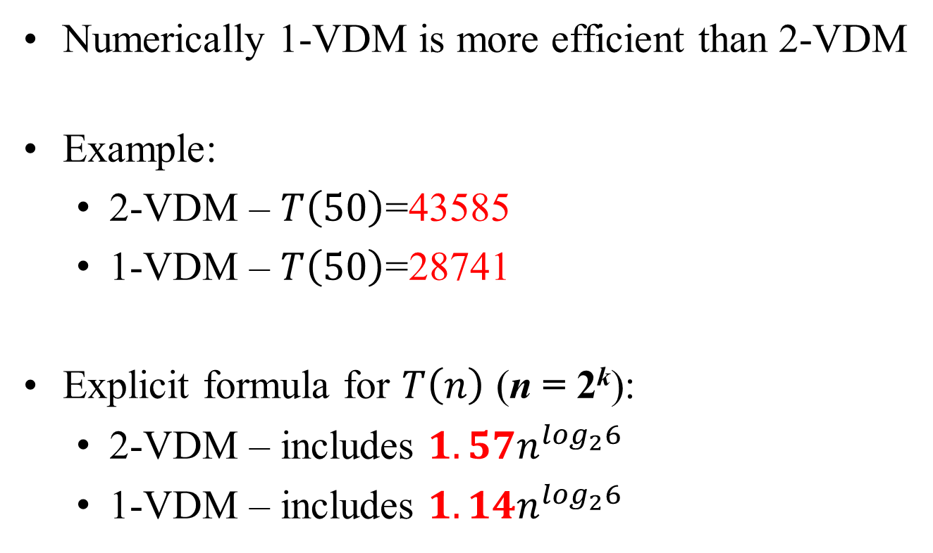
Square Rhomboid:
1-VDM against 2-VDM
Numerically 1-VDM is more efficient than 2-VDM
Example:
  2-VDM – $T\left(50\right)$=43585
  1-VDM – $T\left(50\right)$=28741
Explicit formula for $T\left(n\right)$ (n = 2^{k}):
  2-VDM – includes $1.57n^{\log_{2}6}$
  1-VDM – includes $1.14n^{\log_{2}6}$

Slide 32
Full Square Rhomboid – 2-VDM
p
q-1
i
e_{2i-2}
e_{2i-1}
e_{2i}
e_{2i+1}
i
b_{i}
i+1
p
q
d_{2i-2}
d_{2i-1}
d_{2i}
d_{2i+1}
f_{i-1}
g_{i}
g_{i-1}
f_{i}
p
i
q-1
2 decomposition vertices
New edges (f and g) do not cross the splitting line and are together
with pairs of d and e.
FSR is decomposed like SR

Slide 33
and are decomposed into six subgraphs in a
similar way to and
The total number of labels in the expression for FSR of size n:
The same polynomial complexity!

Slide 34
Full Square Rhomboid – 1-VDM
p
…
i-1
c_{i-1}
i
…
q-1
e_{2i-2}
e_{2i-1}
…
i
…
p
q
d_{2i-2}
d_{2i-1}
f_{i-1}
g_{i-1}
p
…
a_{i-1}
…
i-1
i
q-1
decomposition vertex
New edges (f_{i-1} and g_{i-1}) cross the splitting line.
Any path from p to q passes through vertex i or edges c_{i-1} a_{i-1} g_{i-1} f_{i-1}
additional parts for paths via g_{i-1} and f_{i-1}

Slide 35
Full Square Rhomboid – 1-VDM
p
…
i-1
c_{i-1}
i
…
q-1
e_{2i-2}
e_{2i-1}
…
i
…
p
q
d_{2i-2}
d_{2i-1}
f_{i-1}
g_{i-1}
p
…
a_{i-1}
…
i-1
i
q-1
decomposition vertex
Simplification:

Slide 36
The resulting expression includes eight subexpressions.
Expressions for and are constructed
in the same way.
The total number of labels in the expression for FSR of size n:
Another polynomial complexity!

Slide 37
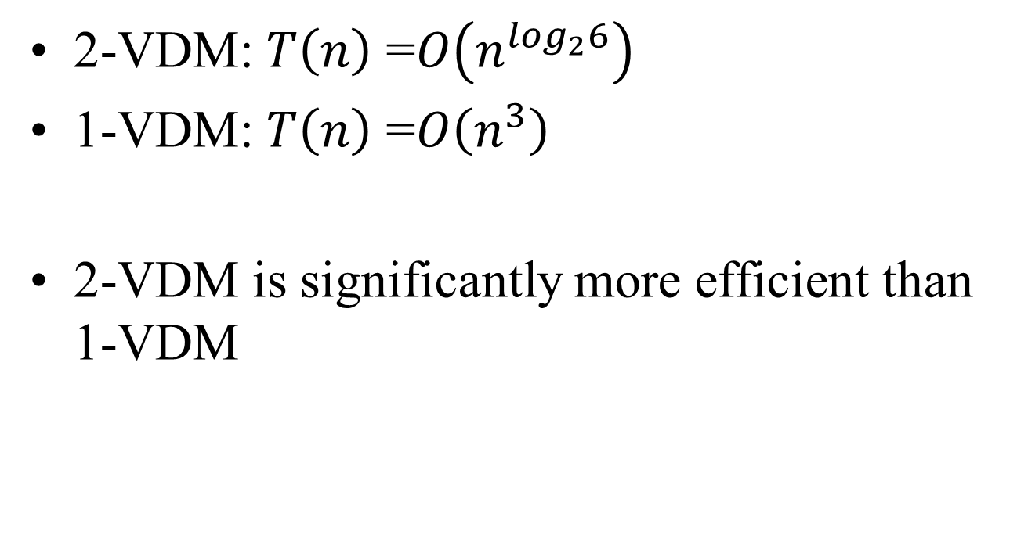
Full Square Rhomboid:
1-VDM against 2-VDM
2-VDM: $T\left(n\right)$ =$O\left(n^{\log_{2}6}\right)$
1-VDM: $T\left(n\right)$ =$O\left(n^{3}\right)$
2-VDM is significantly more efficient than 1-VDM

Slide 38
Theorem. The total number of labels T(n) in the expression for full square rhomboid of size n derived by 2-VDM is defined recursively as follows:

Slide 39
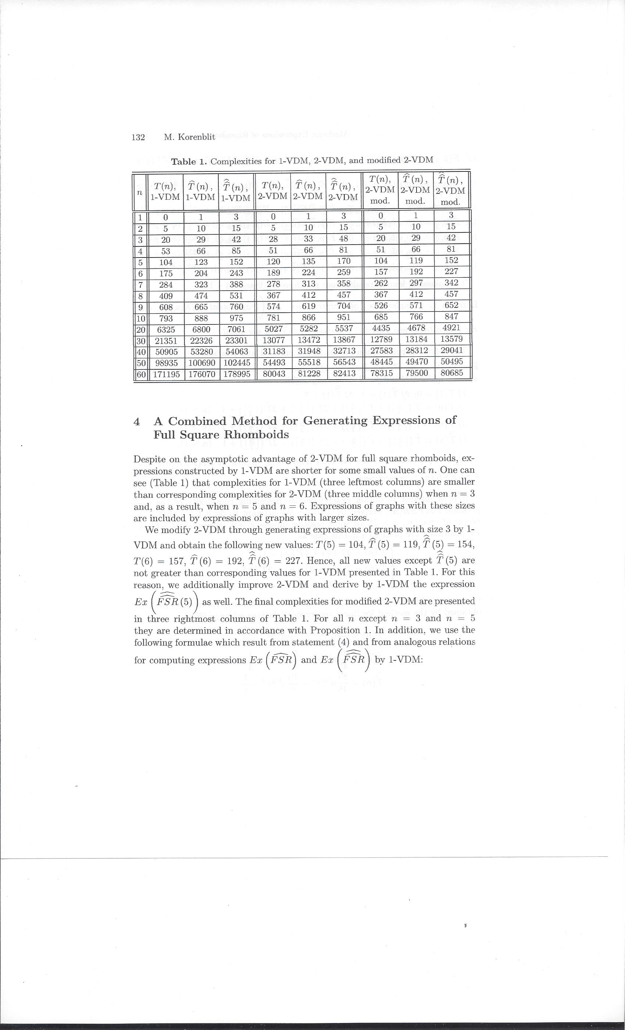
Despite on the asymptotic advantage of 2-VDM for FSR, expressions constructed by 1-VDM are shorter for small n:

Slide 40
Full Square Rhomboid – Modified 2-VDM

Slide 41
Open Problem
What are optimal representations of algebraic expressions of rhomboidal graphs?
At least, what is the order of their sizes?

Slide 42
Conclusions
The existence of a decomposition method for a graph G is a sufficient condition for the existence of an expression with polynomial complexity for G.
The complexity depends, in particular, on the number of revealed subgraphs in each recursive step of the decomposition procedure.
Different decomposition methods may be applied to the same class of graphs and one of the methods may be more efficient for one class and less efficient for another one.

