Slide 1
Three paths to point placement*
Asish Mukhopadhyay
School of Computer Science
University of Windsor, Canada
*Joint work with Md. Shafiul Alam

Slide 2
Talk Outline
Problem statement
A simple and illustrative two rounds algorithm
Our two rounds algorithm
  Part 1: Upper bound
  Part 2: Lower bound
Questions

Slide 3
The problem (1)
Given:
Notes:
n distinct points on a line

Slide 4
The problem (2)
Find the placements of the points
  up to translation and reflection
  by pairwise (adversarial) distance queries
  in one or more rounds

Slide 5
The problem (3)
Queried distances are presented as a
  Query graph or point placement graph (ppg)
  Vertices of the graph correspond to points on the line
Assumption
  Distances returned by the adversary are valid
    Implies a placement of the points exists
Notes:
valid assignment of lengths: possible to check this algorithmically by computing the rank of a Cayley-Menger matrix of the squares of the distances, both known and unknown

Slide 6
A simple and illustrative two rounds algorithm
Notes:
This is to motivate our own algorithm

Slide 7
Line-rigidity of a ppg
Two definitions:
  A ppg is line-rigid for a valid assignment of lengths to its edges if its vertices have a unique placement on a line
  A ppg is line-rigid if its vertices have a unique placement on a line for all valid assignments of lengths to its edges
Next: Two examples

Slide 8
Example of a line-rigid ppg
p₁
p₃
p₂
Notes:
Explain a little: no rigidity condition, length of one edge equal to sum or difference of the other two edges

Slide 9
Example of a ppg
p₁
p₂
p₄
p₃
line-rigid provided, |p₁p₂| ≠ |p₃p₄| or
|p₂p₃| ≠ |p₄p₁|
Notes:
Emphasize rigidity condition; two different placements when the quadrilateral is a parallelogram

Slide 10
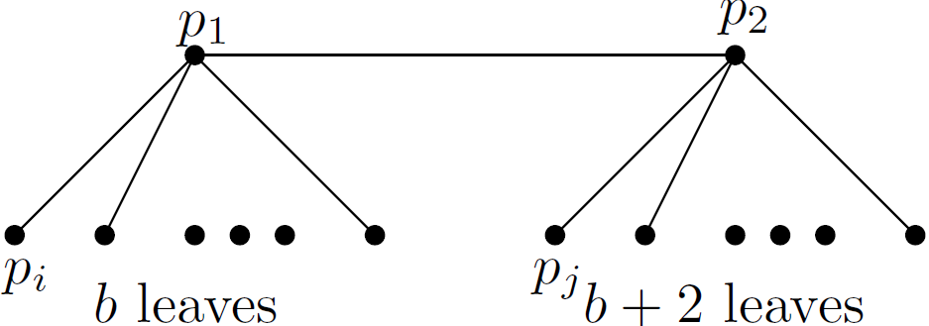
Quadrilateral query graph
n = 2b + 4
Notes:
Connect it to the previous slide

Slide 11
Next...
For each p₁p_{i} , choose p₂p_{j} so that
  |p₁p_{i}| ≠ |p₂p_{j}|
p₁
p₂
p_{i}
p_{j}

Slide 12
Possible ?
Yes! Because of the
  2 extra edges at p₂ and
  The observation that
    At most two equal length edges can be incident to any vertex in a ppg.

Slide 13
Second round queries (1)
Query b edges p_{i}p_{j} ( this gives b line-rigid quadrilaterals ) and
p₁
p₂
p_{i}
p_{j}
Notes:
The length returned by the adversary does not matter

Slide 14
Second round queries (2)
For the two extra edges at p₂, query the edges p₁p_{j} ( this gives two line-rigid triangles )
p₁
p₂
p_{j}

Slide 15
Query complexity
3n/2 - 1

Slide 16
Our two rounds algorithm

Slide 17
Part 1: Upper Bound

Slide 18
Previous Upper Bounds
Year | # Rounds | # Queries | Author
2003 | 1 | 8n/5 | Damaschke
2003 | 2 | 3n/2 | Damaschke
2007 | 2 | 4n/3 +O(√n) | Chin et al
2007 | 3 | 5n/4+O(√n) | Chin et al
2009 | 2 | 10n/7+O(1) | Alam et al
2010 | 2 | 4n/3+O(1) | Alam et al
Notes:
Point out – n is the number of points on a line

Slide 19
Our result
Upper bound of 9n/7 + O(1) on the query complexity

Slide 20
An aside
Asymptotic density
  Query complexity /number of points, as n goes to infinity
In our case:

Slide 21
Layer Graphs
Defining properties
  Each edge parallel to one of two orthogonal (or non-parallel ) directions
  Not all edges parallel to the same direction (implies a two-dimensional extent).
  length of an edge ( = distance between corresponding vertices in the ppg)
  When the layer graph is folded onto a line, either to the left or to the right, no two vertices coincide.
Notes:
Verbal addition: An important tool for deriving rigidity conditions

Slide 22
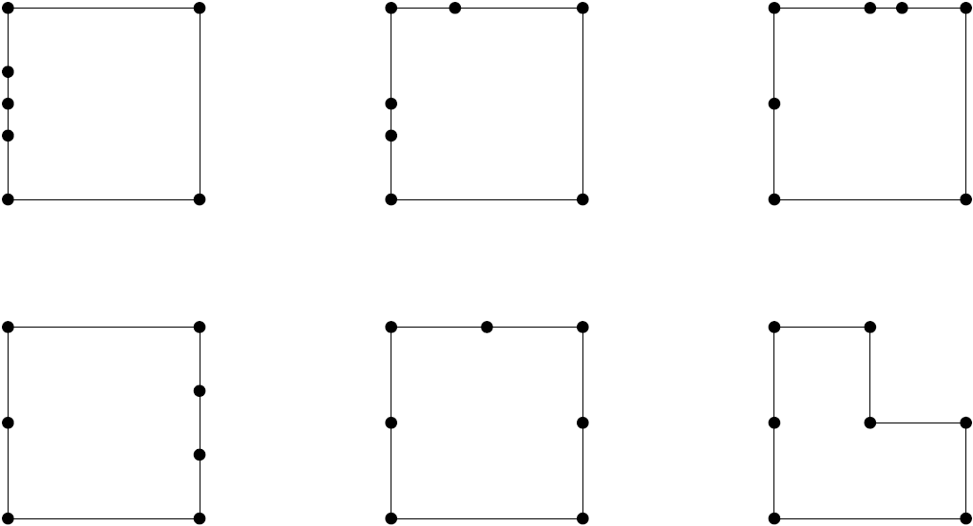
Layer graphs of a 7-cycle
Notes:
Verbal addition: The same 7-cycle can be drawn as a layer graph in many different ways

Slide 23
Main Tool
Theorem:
  A ppg, G, is line-rigid iff it cannot be drawn as a layer graph
Notes:
Line rigid not defined

Slide 24
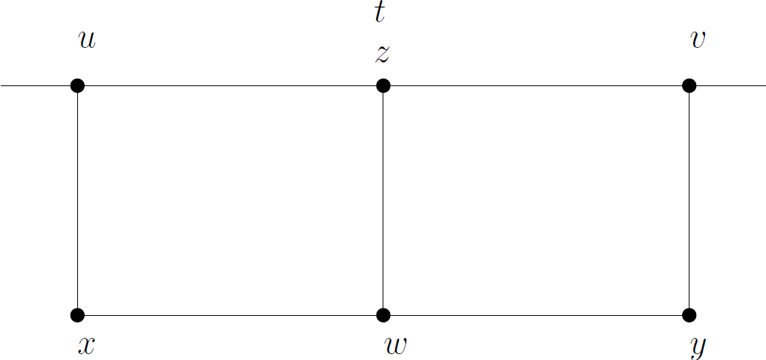
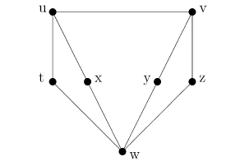
A graph that can’t be drawn as a layer graph
The jewel graph
Not a layer graph as vertices t and z
coincide

Slide 25
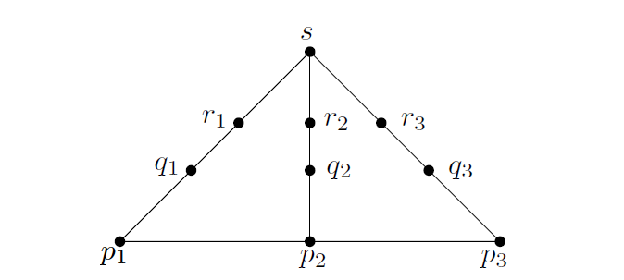
Our invention
The 3-path graph
Notes:
Why does it work ? If p1, p2 and p3 are fixed, we are adding 7 new points and querying 9 new edges. Density is 9/7 if we can carry the construction through
Verbal addition: Basic Building Block, meaning of density

Slide 26
What’s the big deal ?
Relative to fixed p₁, p₂, p₃, 9 edges queried against the addition of 7 points

Slide 27
So the question is...
Can we build
  arbitrarily large graphs
  of asymptotic density 9/7,
  using the 3-path graph
  as a basic building block ?
Yes! we can, provided rigidity conditions can be determined for the 3-path graph
Notes:
This is next!

Slide 28
Finding rigidity conditions
Treat the 3-path graph as:
  A 7-cycle : <p₁, q₁, r₁, s, r₂, q₂, p₂> and
  A 4-cycle : <s, r₃, q₃, p₃>

Slide 29
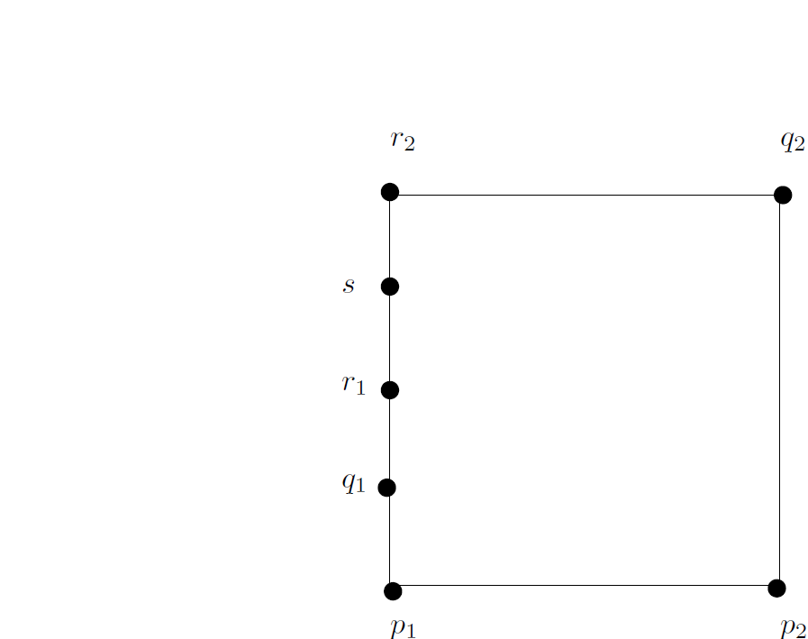
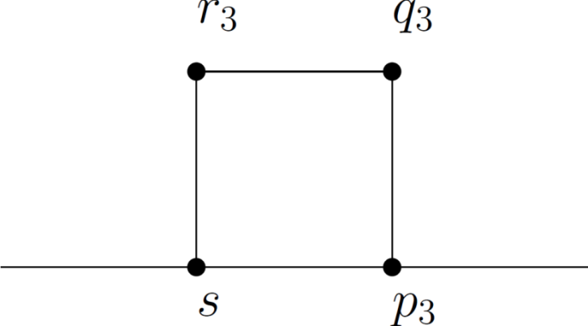
3-path = 4-cycle + 7-cycle

Slide 30
Finding rigidity conditions (contd.)
Fix p₁, p₂, p₃ by a set of first round queries
Find rigidity conditions for the 7-cycle: <p₁, q₁, r₁, s, r₂, q₂, p₂>

Slide 31

Finding rigidity conditions (contd.)
Relative to fixed s and p₃, find rigidity conditions of the 4-cycle <s, r₃, q₃, p₃>

Slide 32
Finding rigidity conditions (contd.)
Rigidity conditions of the 7-cycle are framed sans edges q₁r₁, q₂r₂, q₃r₃
These are queried in the second round…
Notes:
…..and we should be able to meet the rigidity conditions no matter how adversarially their lengths are chosen

Slide 33
Rigidity conditions for 7-cycle
Are found
  by drawing the 7-cycle as a layer graph
We have
  42 different layer graph representations in 6 groups
Leading to
  42 different rigidity conditions
Notes:
Verbal addition: How 42 ? We had a formula: 2^{n-1} - (n² – n + 2)/2. For n=7 this gives 64 – 22 = 42
Verbal addition: How do you form the groups ?

Slide 34
6 groups of layer graphs for the 7-cycle
Notes:
The left corner in each graph can be cyclically labeled in 7 different ways. Hence 7 X 6 = 42 different conditions
Where is this picture file ?

Slide 35
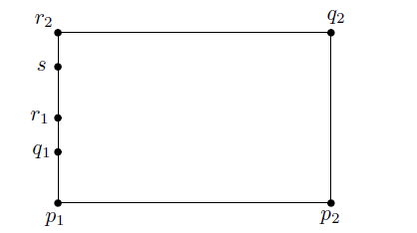
Rigidity conditions for a 7-cycle
Configuration:
  3 points on one side
Notes:
Need a picture here. True! This pic is taken from MSA’s FSTTCS submission

Slide 36
Rigidity conditions for a 7-cycle
These are:
  |p₁p₂| ≠ |q₂r₂|
  |p₁p₂| ≠ |q₁r₁|
  |p₂q₂| ≠ |r₂s|
  |p₁q₁| ≠ |r₁s|
  |q₂r₂| ≠ |r₁s|
  |q₁r₁| ≠ |r₂s|
  |p₁q₁| ≠ |p₂q₂|
Notes:
Group 1 from the FST & TCS submission; each of these conditions is obtained by a cyclic shift of the labels clockwise one position, starting with the initial labeling shown. The rigidity condition is always on the 2 opposite edges that are free of any other points

Slide 37
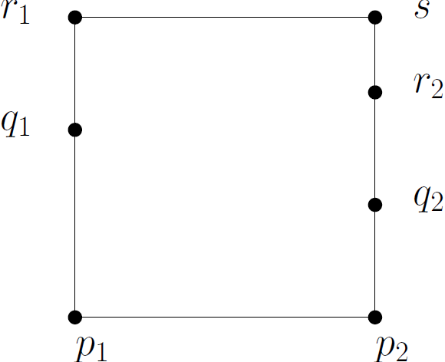
Rigidity conditions for a 7-cycle
  Configuration:
    2 points on one side and 1 on the opp. side
Notes:
This is group 4 in the same submission, page 3.

Slide 38
Rigidity conditions for a 7-cycle
These are:
  |p₁p₂| ≠ |r₂s|
  |p₁p₂| ≠ |r₁s|
  |p₂q₂| ≠ |r₁s|
  ||p₁q₁| |p₂q₂| |p₁p₂||
  ≠ ||r₁s| |r₂s||
  |p₂q₂| ≠ |q₁r₁|
  |q₁r₁| ≠ |r₂s|
  |p₁q₁| ≠ |q₂r₂|
Notes:
Group 1 from the FST & TCS submission; each of these conditions is obtained by a cyclic shift of the labels clockwise one position, starting with the initial labeling shown. The rigidity condition is always on the 2 opposite edges that are free of any other points

Slide 39
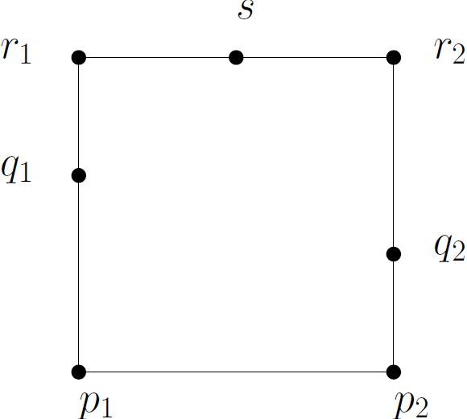
Rigidity conditions for a 7-cycle
Configuration:
  1 point on each of 3 adjacent sides
Notes:
This is group 5 in the same submission, page 3.

Slide 40
Rigidity conditions for a 7-cycle
These are:
  |p₂q₂| ≠ ||p₁p₂| |r₁s||
  |p₁q₁| ≠ ||p₁p₂| |r₂s||
  |p₁q₁| ≠ ||p₁p₂| |r₁s| |r₂s||
  |p₂q₂| ≠ ||p₁p₂| |r₁s| |r₂s||
  |p₁q₁| ≠ ||q₂r₂| |r₂s||
  |p₂q₂| ≠ ||q₁r₁| |r₂s||
  |p₁p₂| ≠ ||r₁s| |r₂s||
Notes:
Group 1 from the FST & TCS submission; each of these conditions is obtained by a cyclic shift of the labels clockwise one position, starting with the initial labeling shown. The rigidity condition is always on the 2 opposite edges that are free of any other points

Slide 41
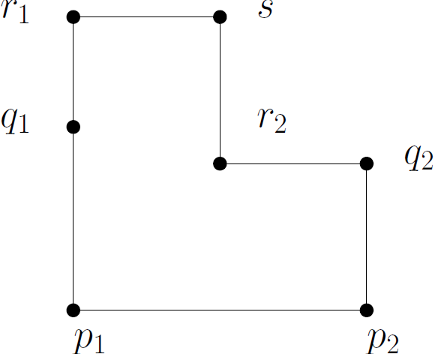
Rigidity conditions for a 7-cycle
Configuration:
  The staircase structure
Notes:
This is group 5 in the same submission, page 3.

Slide 42
Rigidity conditions for a 7-cycle
These are:
  ||p₁q₁| |q₁r₁|| ≠ ||p₂q₂| |r₂s||
  ||p₂q₂| |q₂r₂|| ≠ ||p₁q₁| |r₁s||
  |q₁r₁| ≠ ||p₂q₂| |r₂s||
  |q₂r₂| ≠ ||p₁q₁| |r₁s||
  |p₂q₂| ≠ ||p₁q₁| |r₁s||
  |p₁q₁| ≠ ||p₂q₂| |r₂s||
  |p₂q₂| ≠ ||p₁q₁| |r₁s| |r₂s||
Notes:
Group 6from the FST & TCS submission; each of these conditions is obtained by a cyclic shift of the labels clockwise one position, starting with the initial labeling shown. The rigidity condition is always on the 2 opposite edges that are free of any other points

Slide 43
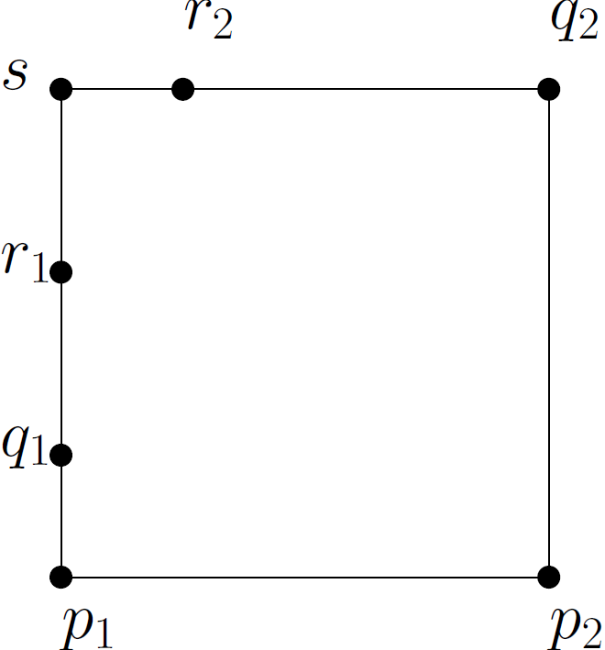
Rigidity conditions for a 7-cycle
Configuration:
  2 points on one side and a third on an adjacent side clockwise to it
Notes:
This is group 5 in the same submission, page 3.

Slide 44
Rigidity conditions for a 7-cycle
These are:
  |r₁s| ≠ ||p₁p₂| |p₁q₁|
  |r₂s| ≠ ||p₁q₁| |q₁r₁|
  |r₂s| ≠ ||p₁p₂| |p₁q₁| |p₂q₂||
  |p₂q₂| ≠ ||r₁s| |r₂s||
  |p₁p₂| ≠ ||q₂r₂| |r₂s||
  |p₁q₁| ≠ ||p₂q₂| |q₂r₂||
  |q₁r₁| ≠ ||p₂q₂| |p₁p₂||
Notes:
Group 3 from the FST & TCS submission; each of these conditions is obtained by a cyclic shift of the labels clockwise one position, starting with the initial labelling shown. The rigidity condition is always on the 2 opposite edges that are free of any other points

Slide 45
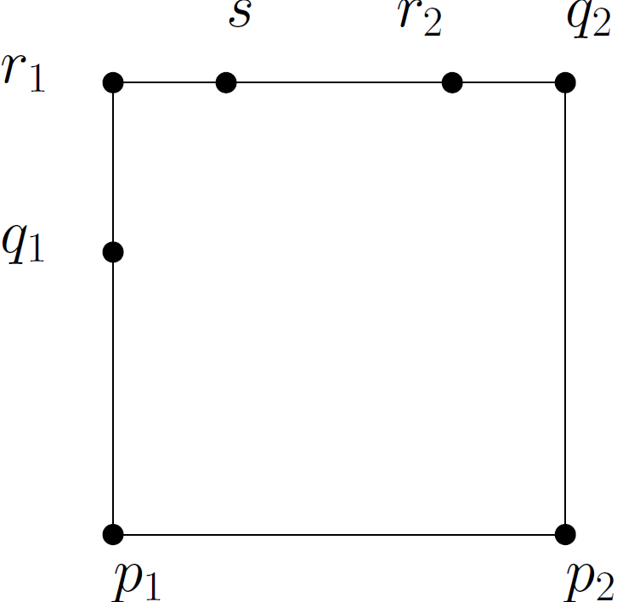
Rigidity conditions for a 7-cycle
Configuration:
  2 points on one side and a third on an adjacent side counter-clockwise to it
Notes:
This is group 5 in the same submission, page 3.

Slide 46
Rigidity conditions for a 7-cycle
These are:
  |r₂s| ≠ ||p₁p₂| |p₂q₂|
  |r₂s| ≠ ||p₂q₂| |q₂r₂|
  |r₁s| ≠ ||p₁p₂| |p₁q₁| |p₂q₂||
  |p₁q₁| ≠ ||r₁s| |r₂s||
  |p₁p₂| ≠ ||q₁r₁| |r₁s||
  |p₂q₂| ≠ ||p₁q₁| |q₁r₁||
  |q₂r₂| ≠ ||p₁q₁| |p₁p₂||
Notes:
Group 3 from the FST & TCS submission; each of these conditions is obtained by a cyclic shift of the labels clockwise one position, starting with the initial labelling shown. The rigidity condition is always on the 2 opposite edges that are free of any other points

Slide 47
Reworking 20 conditions
That involve |q₁r₁|,|q₂r₂|, |q₃r₃|
Goal:
  Meet rigidity conditions without these

Slide 48
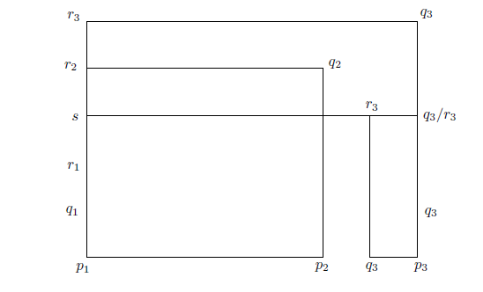
Example: |p₁p₂| ≠ |q₂r₂|
Idea:
  Consider the 7-cycle concurrently with the 4-cycle
Notes:
This figure encapsulates all the 4 figures of Fig.3 in the FSTTCS paper

Slide 49
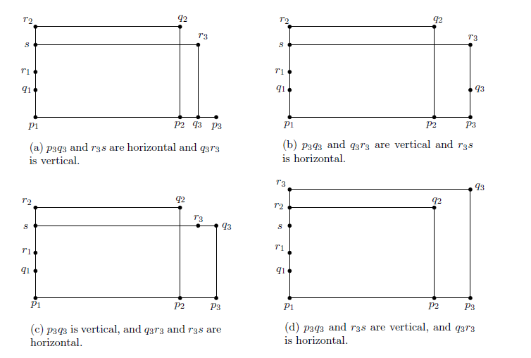
An expanded figure
Notes:
Taken from the FSTTCS submission ; here we have 4 different drawings of sr₃q₃p₃

Slide 50
New conditions
Considering the 4 different drawings of <sr₃q₃p₃>
  |p₁p₃| ≠ ||p₃q₃| |r₃s||
  |p₁p₃| ≠ |r₃s|
  |p₂q₂| ≠ ||p₃q₃| |r₂s||
  |p₂q₂| ≠ ||p₃q₃| |r₃s| |r₂s||
Similarly, we rework all the other rigidity conditions involving the edges |q₁r₁| and |q₂r₂|

Slide 51
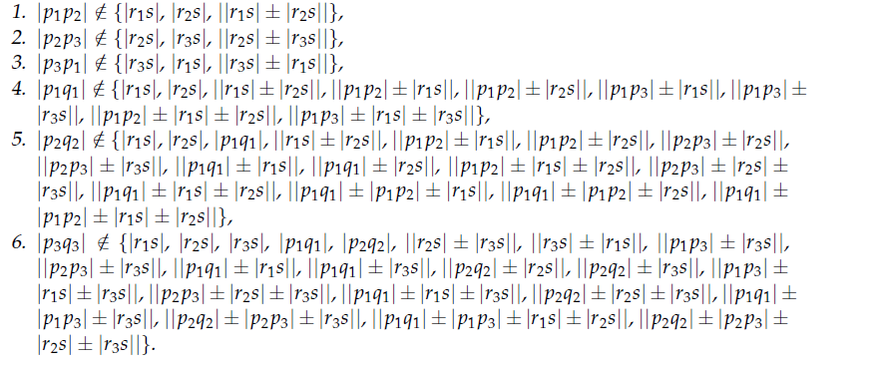
A set of 55 sufficient conditions
Notes:
Explain in a separate slide why 19 points are needed to satisfy the first 3 sets of conditions

Slide 52
Choosing p₁, p₂, p₃ from a pool S
The first 3 impose restrictions on the mutual distances between p_{i} and p_{j}
Need a pool S of p_{i}’s with enough choices to meet these length restrictions

Slide 53
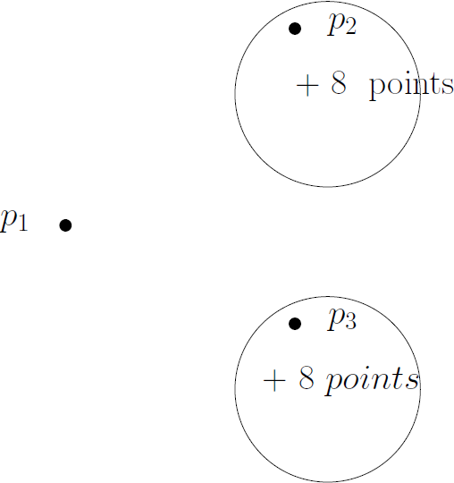
Look at the 1st 3 conditions
These are all candidate p₃’s
relative to p₂ exactly one of
which is a candidate relative
to p₁
Need a buffer of 19 points
Notes:
MSA’s explanations are so incomprehensible!!
Feb, 2015: the above explanation in the slide is correct

Slide 54
Size of S ?
Valence of a point p_{i} in S be
  # of times it is used in constructing a 3-path component
|S| = 35 ensures
  |valence(p_{i} ) – valence(p_{j} )| ≤ 2
Notes:
Why the term valence ?
You have to justify why you would want to do this.
*Shafiul’s write-up is quite messy. Here’s my version of it.
Initially, all the points in the pool have valence 0. To pick three points of minimum valence (0 in this case) to
beat 16 different length restrictions in all, we need a buffer of size at least 17. Thus we can pick 6 triplets
(p1, p2, p3) of valence 0, until the buffer limit is reached. At the end of this cycle, 18 points have valence 1
and 17 points have valence 0.
The next cycle begins by picking pairs (p1, p2) from the pool of 17 points of valence 0, as long as we have a
buffer of size 9. Since we don’t have enough points in the buffer to ensure that the third point p3 is from the valence
0 pool, we might have to pick these from the pool of valence 1 points. So up to 4 points can have valence 2. Thus the pessimistic
distribution of valence at the end of this 2nd cycle is 22 points of valence 1, 4 points of valence 2 and the rest 9 of valence 0.
See also notes on the three path paper that I wrote up with Pijush. 35 is the correct number; unfortunately, the paper was submitted to CALDAM without this correction.

Slide 55
Formally..
Lemma :
  A pool S of 35 points is sufficient to ensure that the valence of any 2 points p_{i} and p_{j} differ by at most 2
Notes:
The proof is interesting. See my write-up: “notesOnThreePath.pdf” in this directory.

Slide 56
How to make S Line rigid ?
Hang 6 jewels from a common strut uv
A Jewel

Slide 57
How to make S Line rigid ?...
Takes care of the line rigid placement of 32 points (6 x 5 + 2)
Rest 3 points are made line rigid by hanging 3 triangles from the same common strut uv as the jewels
55 first-round edge queries in total

Slide 58
Rest of the graph
Let n = 245b + 4419 be the number of points, b is a positive integer
Notes:
This choice will become clear soon. What about other values of n ? n< 4664 (use triangle or quadrilateral queries); n between 245b + 4419 and 245(b+1) + 4419 ? In the latter case, the additional points between 1 and 244 can be placed by separate triangle or quadrilateral queries. The factor 9/7 will remain unchanged.

Slide 59
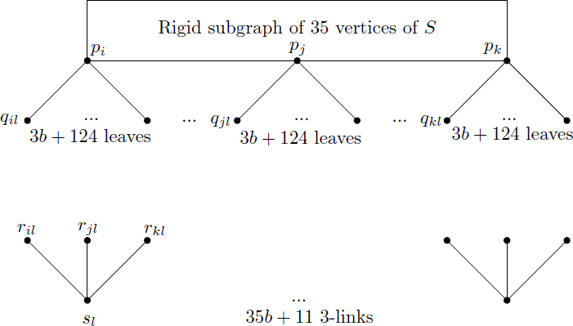
3-path based query graph
Notes:
This graph needs to be corrected - done!

Slide 60
|V| = ?
4(35b + 11) + 35(3b+124) + 35
245b + 44+ 35.125= 245b + 4419
Notes:
44 + 35.125 = 44 -125 + 36. 125 = -81 + 36. 500/4 = -81 + 4500 = -81 + 100 + 4400 = 4419

Slide 61
Number of 3-path components ?
Let x be
  # of 3-path components
Then
  3x = 18.3b + 17.(3b+2)* as each component uses 3 points from S
So, x is roughly
  35b + 11
Notes:
18 points of valence 3b and 17 of valence 3b+2 – worst case scenario

Slide 62
Why a buffer of 124 leaves at each p_{i} ?
Take p_{i}q_{i}, for instance
  There are 20 different lengths that |p_{i}q_{i} | can’t be equal to
  As each of these can be realized in 2 ways by placing a point on either side of p_{i} on the line, we need a buffer of size at least 40 to chose a q_{i} that meets the rigidity conditions
For p_{j}q_{j} we need a buffer of size 90 to meet the rigidity conditions on p_{j}q_{j}

Slide 63
Why a buffer of 124 leaves at each p_{i} ?
For p_{k}q_{k} we need a buffer of size 122 to meet the rigidity conditions on p_{k}q_{k}
Thus a buffer of size 122 covers all three cases
Add 2 to this count to cover the situation where a p_{i} can be used an additional 2 times in the construction of a component
Thus 124 additional leaves at every p_{i} cover all the possibilities
Notes:
Now what ?

Slide 64
Building a 3-path component
For each 3-prong (bottom of query graph), pick a triplet of points (p_{i}, p_{j}, p_{k}) from S, satisfying the valence requirements
Notes:
*note that the length of the first edge is involved in the rigidity conditions of the second, and the lengths of the first and second edges are involved in the choice of the third

Slide 65
Building a 3-path component
Next pick an edge incident on each of p_{i}, p_{j} and p_{k}, in that order*, and respecting the rigidity conditions on these edges as determined by the choice of the prong in the previous step

Slide 66
Unused leaves at the p_{i}’s
Pair up unequal edges incident at different p_{i}’s for quadrilateral queries
For an unpaired residual leaf make triangle query with respect to a different p_{i} than the parent of the leaf node to form a triangle
Notes:
Note the edges that complete the quadrilaterals and triangles are queried in the second round

Slide 67
Second round
The edges that complete the 3-path components, the quadrilaterals and the triangles are all queried in the second round

Slide 68
Finally a..
Theorem
  9n/7 + 6534/7 queries are sufficient to place n distinct points on a line
Proof
  # edge-queries in 1st round: 210b + 4428
  # edge-queries in 2nd round: 105b + 2187
  Thus 315b + 6615 edge-queries to place 245b+4419 points
  315b + 6615 = 315/245 (245b + 4419) + 6615 – 9/7*4419 = 9n/7 + 6534/7

Slide 69
Part 2:Lower Bound

Slide 70
Previous results
Year | #rounds | #queries | author
2003 | 1 | 4n/3 | Damaschke
2006 | 2 | 30n/29 | Damaschke
2007 | 2 | 17n/16 | Chin et. al.
2010 | 2 | 14n/13 | Alam et. al.

Slide 71
Our Result
Improved lower bound of
  9n/8 on any 2-round deterministic algorithm

Slide 72
Restating our Result
Recall:
  ρ = |E|/|V| is the density of a ppg
To restate our result:
  9/8 ≤ ρ
In words:
  9/8 is a lower bound on the density of any line-rigid ppg constructed in two rounds

Slide 73
Technique
Adversarial in which
  A is any 2-round point placement algorithm
  B is an adversary
A ‘s goal
  create a line-rigid graph in two rounds
B‘s goal:
  prevent this by introducing ambiguities in the placement

Slide 74
First Round
A presents B with a partial ppg:
  G₁ = (V, E₁)
Guided by 4 strategies, B responds by:
  fixing the placements of all vertices of degree 3 or more (heavy vertices), with some exceptions, and
  setting lengths of edges to create ambiguity in the placements of the vertices

Slide 75
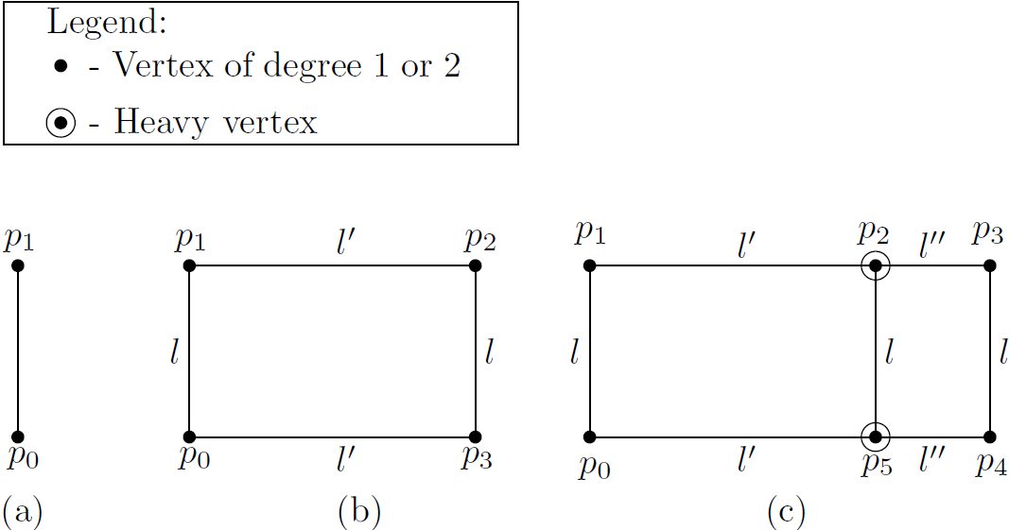
Ambiguity Creating Tool
  Handles

Slide 76
Creating handles in G₁
Strategy S₂ is used to create handles in paths of degree 2 vertices periodically

Slide 77
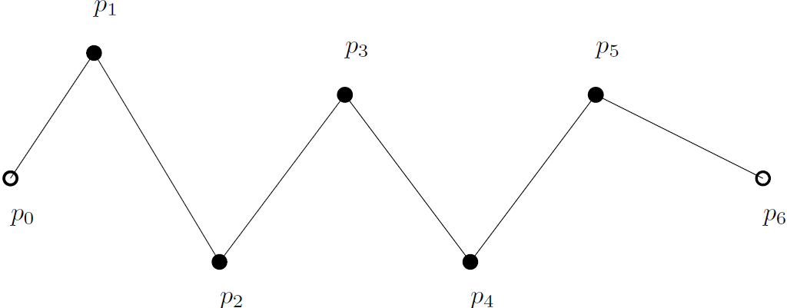
Creating handles in G₁
A path p₁p₂…p₅ of degree 2 vertices in G₁

Slide 78
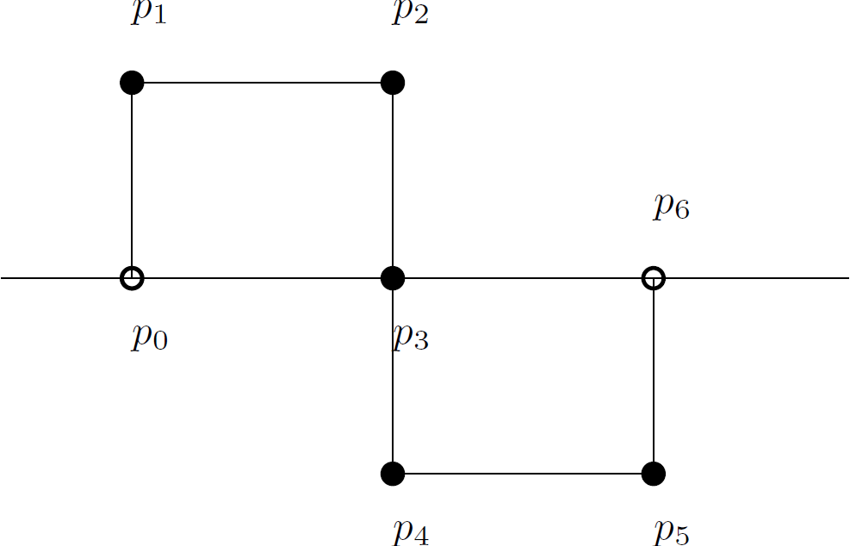
Creating handles periodically in G₁

Slide 79
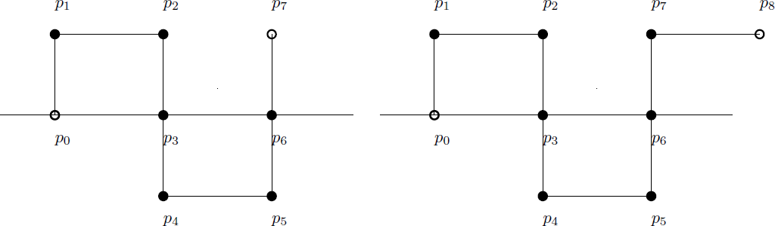
Creating handles periodically in G₁
Configurations with residual edges
Incomplete handles

Slide 80
Creating potential handles in G₁
Strategies S₁, S₃ and S₄ are used

Slide 81
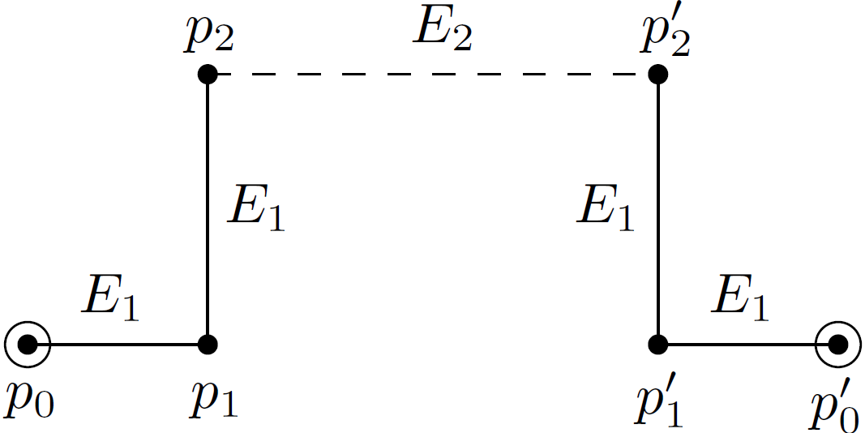
A potential handle in G₁
|p₁p₂|= |p₁’p₂’|= c

Slide 82
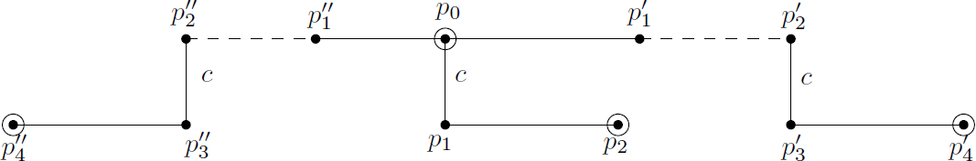
Another potential handle in G₁
A more complicated example

Slide 83
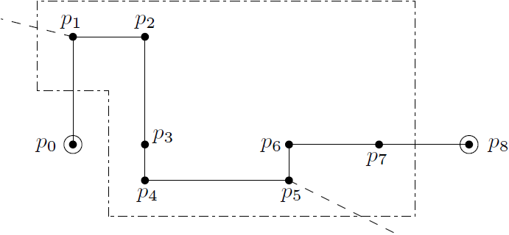
Handle disambiguation by A
Adding extra edges at p₁ and p₅

Slide 84
Finally, a..
Theorem:
  The minimum density of the line rigid query graph for any 2-round algorithm is at least 9/8
Notes:
The use of the adjective “minimum” is correct because the minimum density of a node is a lower bound on the density of a particular query graph; a lower bound on this minimum density covers all query graphs.

Slide 85
Proof sketch

Slide 86
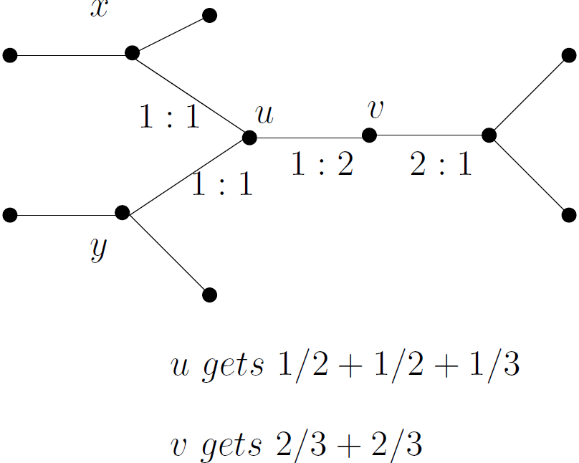
Edge-splitting (1)

Slide 87
Edge-splitting (2)
By edge splitting
  each vertex or group of vertices in the graph ends up owning a fraction of all the edges in the graph.
  this fraction is the density of the individual vertex or the average density of the group
  sum of all these fractions is |E|

Slide 88
Edge-splitting (3)
Some edges in E₁ are split in the ratio 3:5
Rest of the edges in E₁ and E₂ are split in the ratio 1:1

Slide 89
Minimum density and lower bound
The minimum density over all individual vertices and groups of vertices is a lower bound on ρ = |E|/|V|.
A lower bound on this minimum density is a lower bound on the density of all query graphs.
We show this to be 9/8

Slide 90
Vertex classification
A vertex in V is of
  Type A or
  Type B
Notes:
Verbal addition: The proof is fairly elaborate.
Other degree 2 nodes are created in the second round; in G₂ there are no degree 1 nodes

Slide 91
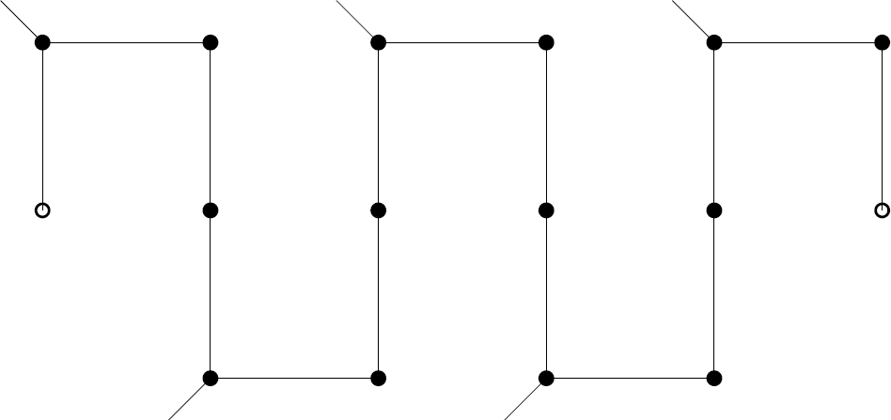
Type A vertices (solid disks)
Class A path

Slide 92
Class A path
Minimum density ρ_{A} satisfies
  ρ_{A} ≥ 9/8
Follows from:
  1/k[ k+ floor((k+1)/3)x1/2] ≥ 9/8
  k : number of vertices in the path

Slide 93
Type B vertices (1)
Rest of the vertices in V

Slide 94
Type B vertices (2)
These are grouped around heavy vertices in the following way:
  Let v be a heavy vertex of G₂
  Consider all maximal paths of degree 2 in G₂ that connect it to other heavy vertices
Notes:
Verbal addition : Does this include the terminal heavy nodes for maximal paths considered in the previous slide ? Which nodes are these ? All heavy nodes of G2 (some of which were created in the second round), all degree 2 nodes created during the second round and all degree nodes that were not part of the maximal paths considered in the first part.

Slide 95
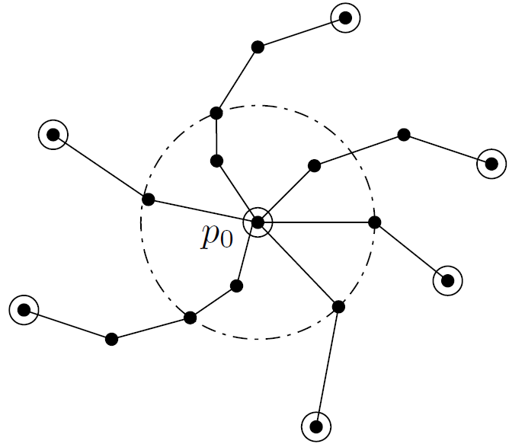
nbr-hood of a type B heavy vertex p₀

Slide 96
Two types of sub-groups
There is no path incident on a Type A vertex
  Call this Type B₁
There exists such a path
  Call this Type B₂
An involved argument shows that it is enough to consider 3 paths incident on a vertex of either type
We will assume this

Slide 97
Type B₁
Heavy vertices in G₂ that are connected to heavy vertices of type B only, by paths of degree 2 vertices in G₂
  Edge accounting
    Edges are split equally between the terminal heavy vertices
Notes:
Enough to consider heavy nodes with exactly 3 incident paths. Consider a 4th incident path. Longer the path the smaller the contribution to the average density of the heavy node group
In fact, the longest path will have 3 degree 2 nodes and the contribution to the average density is:
((3+1)/2)/(3/2) = 4/3 > 9/8*

Slide 98
Type B₁ contd.
  Let m be the total number of vertices in the 3 paths incident on a heavy vertex v
    average density of ½ of these m vertices that attach to v , plus v is:
      (½*m + 3/2)#/(1/2*m +1) ≥ 9/8 for m ≤ 6
Notes:
*denominator is 3/2 since the 3 nodes are split between the 2 terminal heavy nodes, while the numerator count is (3+1)/2(1 from the second edge ,½ from the third and ½ from the first)
# consider a ½ edge on each side of each of the ½ m nodes and then three ½ edge from each incident path to the heavy node v

Slide 99
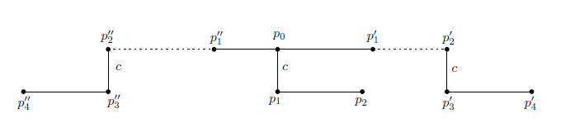
What if …
m > 6 ?
  m = 7
    A potential handle is created, where the adversary also sets edge lengths in E₂
Notes:
Here S3 and S4 are fully utilized.

Slide 100
What if…
m > 6
  m = 8, 9
    Once again, a potential handle is created by the adversary, using S₃ and S₄ and setting edge lengths in E₂

Slide 101
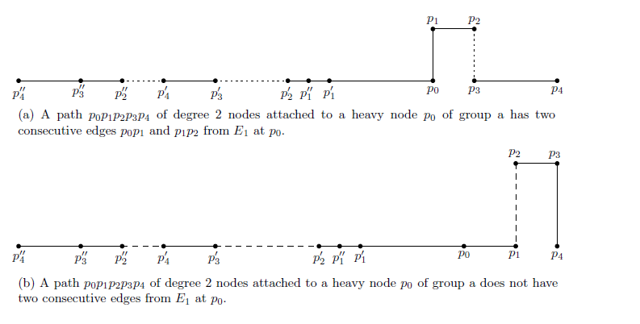
What if…

Slide 102
In each of these cases..
Disambiguation by the algorithm reduces the cases to m ≤ 6

Slide 103
Type B₂
Heavy vertices in G₂ that are connected to at least one vertex of Type A by at least one path of degree 2 vertices in G₂
  Let v be a type B₂ heavy vertex

Slide 104
Type B₂
Average density with 3 paths incident on v can again be argued to be ≥ 9/8 for all combinations of paths

Slide 105
End of talk

Slide 106
Questions ?

Slide 107
Unused Slides

Slide 108
Our Results
New 2-round deterministic algorithm with
  upper bound of 9n/7 + O(1) or,
  performance ratio of 9/7 + o(1)
Improved lower bound of
  9n/8 on any 2-round deterministic algorithm

Slide 109
Our Results
New 2-round deterministic algorithm with
  upper bound of 9n/7 + O(1) or,
  performance ratio of 9/7 + o(1)
Improved lower bound of
  9n/8 on any 2-round deterministic algorithm

Slide 110
4-edges on one side
s -> p3: s up r₃ right q₃ down p₃; s right r₃ down q₃ right p₃ ;
s right r₃ right q₃ down p₃; s right r₃ down q₃ down p₃
Notes:
Interpreting the figure ? The 7-cycle is fixed, as well as p3; this is the first diagram on the previous slide; next different paths from s to p3 are considered. There are 4 shown. All possibilities must be taken care of. Provably, how ? The different paths should have been drawn in different colors.
This is not how he did it in the FST & TCS version. He considers the conditions on the rigidity of the 7 cycle first, again in 6 groups,
corresponding to the configurations on slide 12.

Slide 111
4-edges on one side
s up r₃ right q₃ down p₃
  |p₃q₃| +/- |r₃s| ≠ |p₂q₂| +/- |r₂s| is the rigidity condition
s right r₃ down q₃ right p₃
  |p₃q₃| +/- |r₃s| ≠ |p₁p₃|
s right r₃ down q₃ down p₃
  |p₁p₃| ≠ |sr₃|
s right r₃ right q₃ down p₃
  |p₃q₃| ≠ |p₂q₂| +/- |r₂s|
Notes:
All cases have been worked out. I get the hang of all this now. None of the prohibited edges appear here.

Slide 112
4-edges on one side
6 additional sets of conditions
Notes:
The details have been painstakingly worked out

Slide 113
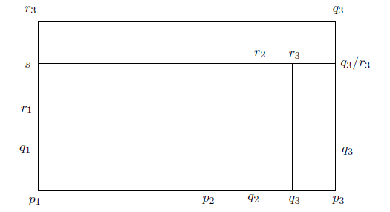
3 edges on one side and the other 2 on an adjacent side
Notes:
This corresponds to the 2nd and 3rd figures on slide 12. The explanation is the same as for the previous slide – various paths to p3 have been
Worked out

Slide 114
3 edges on one side and 2 on an adjacent side
s up r₃ right q₃ down p₃
  |p₃q₃| +/- |r₃s| ≠ |p₂q₂| +/- |r₂s| is the rigidity condition
s right r₃ down q₃ right p₃
  |p₃q₃| +/- |r₃s| ≠ |p₁p₃|
s right r₃ down q₃ down p₃
  |p₁p₃| ≠ |sr₃|
s right r₃ right q₃ down p₃
  |p₃q₃| ≠ |p₂q₂| +/- |r₂s|
Notes:
He has just two conditions for this one!

Slide 115
Previous results
Upper bound
  Damaschke, 2003, 8n/5 queries, 1-round
  Damaschke, 2003, 3n/2 queries, 2-round
  Chin et al, 2007, 4n/3 + O(√n) queries, 2-round
  Chin et al, 2007, 5n/4 + O(√n) queries, 3-round
  Alam , Mukhopadhyay & Sarker, 2009, 10n/7 +O(1) queries, 2-round
  Alam & Mukhopadhyay, 2010, 4n/3 +O(1) queries, 2-round

Slide 116
Previous results
Lower bound
  Damaschke, 2003, 4n/3 queries, 1-round
  Damaschke, 2006, 30n/29 , 2-round
  Chin et al, 2007, 17n/16 , 2-round
  Alam & Mukhopadhyay, 2010, 14n/13, 2-round

Slide 117
Creating handles in G₁
  Adversary’s strategy
    When p₀ and p_{k+1} are of degree 3 or more, handles are created periodically by setting |p_{i-1}p_{i}|=|p_{i+1}p_{i+2}| and |p_{i}p_{i+1}| = p_{i-1}p_{i+2}| for i = 1 (mod 3)

Slide 118
Lower bound
  Adversary’s strategy
    Let p₁p₂…p_{k} (k ≥2) be a path of degree 2 vertices
A path p₁p₂…p₅

Slide 119
A consequence of S₂ and S₃
Lemma:
  A maximal path P of degree-2 nodes in G₂ has at most 3 nodes
Proof:
  If the path consists of edges in E₁ only, then by S ₂ it can have at most 3 degree-2 nodes; for if the handles are periodic, then we can have 3 consecutive nodes,
  Else, any 3 consecutive edges can be used to create a handle; then, we can have only 2 consecutive degree- 2 nodes

Slide 120
Proof of Lemma contd.
Proof:
  Let P have at least one edge in E₂.
  By S₂ , there can be at most 2 consecutive edges in E₁.
  Let P have 4 degree-2 nodes, p₁, p₂, p₃ and p₄ and p₀ and p₅ are adjacent to p₁ and p₄ respectively.
  Then P has one of the following combinations of edge types (next slide)

Slide 121
Proof of Lemma contd.
    E₂, E₁, E₂, E₁, E₁
    E₂, E₁, E₁, E₂, E₁
    E₁, E₂,E₁, E₂, E₁
    E₁, E₁, E₂, E₂, E₁
    E₁, E₁, E₂, E₁, E₁

Slide 122
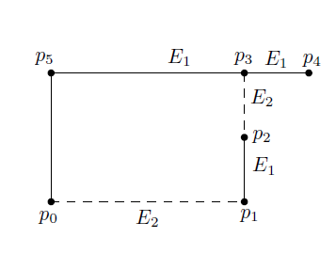
Proof of Lemma contd.
Proof:
  Consider combination 1.
  The figure below shows that the 2 edges in E₂ can be set by the adversary to create a generalized handle

Slide 123
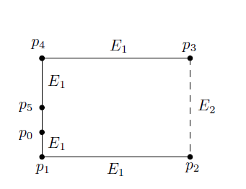
Proof of Lemma contd.
Proof:
  As an example of the application of S₃ by the adversary, consider combination 5 : E₁, E₁, E₂, E₁, E₁
  Setting |p₁p₂| =|p₃p₄| = c and the length of the edge in E₂ to |p₄p₅| + |p₅p₀| +|p₀p₁| the adversary can create a generalized handle

Slide 124
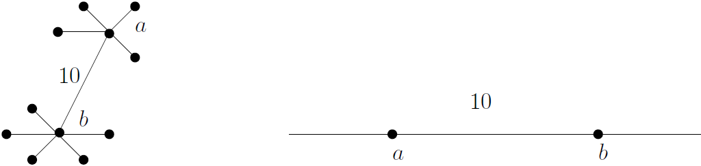
Improved lower bound on 2-round algorithms
First round
  Query Graph : G₁ = (V, E₁)
  Adversary’s strategy
    S₁: Fix the layout of all vertices of degree 3 more and report the lengths of edges, connecting pairs of these vertices in E₁, consistent with this layout.

Slide 125
Lower bound
  Adversary’s strategy
    When, say, p_{k+1} , is of degree 1, set |p_{i-1}p_{i}|=|p_{i+1}p_{i+2}| for i = 1 (mod 3), and the length of alternate edges equal, that is, |p_{i-1}p_{i}|=|p_{i+1}p_{i+2}| for i = 1 (mod 2)
    The latter condition allows a handle to be created with any 3 consecutive edges

Slide 126
Lower bound
  Adversary’s strategy
    S₃: For all degree 2 nodes, if one of the incident edges is also incident on a degree 1 node, set the length of any of the incident edges to c
    Let P₁, P₂ and P₃ be the maximal paths of degree 2 nodes, incident on a degree 3 node of V
    S₄: If P₁ and P₂ are terminated by a degree 1 node, while P₃ is terminated by a heavy node, then one of the edges of P₃ is set to c
Notes:
Verbal addition: These may sound somewhat strange, but as we shall see these are used by the adversary to create generalized handles

Slide 127
Remarks on strategies S₃ and S₄
These are used by the adversary to create a generalized handle in the second round
Notes:
Slide necessary ?

Slide 128
Vertex classification
Proof (contd.):
  The nodes are divided between 2 bins
  binOne consists of nodes of degree 2 in a maximal path in G₁, with at least 2 nodes of degree 2 and terminated by heavy nodes present in G₁;
    these are Type A nodes
  To estimate the minimum density of such nodes we note that edges in E₂ are possibly attached to these nodes to remove the ambiguity caused by the creation of handles.
    Each such attached edge is split in a 1:1 ratio between its end-nodes.
    Such edges are added periodically, with a period of 3.
Notes:
Verbal addition: The proof is fairly elaborate.
Other degree 2 nodes are created in the second round; in G₂ there are no degree 1 nodes

Slide 129
A final theorem
Proof (contd.):
  With k degree -2 nodes, the average density of Type A node is :
    1/k[ 2x1/2 + k-1 + floor((k+1)/3)x1/2]
      the first term is due to the terminal heavy nodes,
      the second due to the k-1 intermediate edges in E₁,
      the last due to the edges attached, at worst, to every third node to remove ambiguity caused by the creation of handles by the adversary.
    1/k[ 2x1/2 + k-1 + floor((k+1)/3)x1/2] ≥ 9/8, with equality attained for k=4.
    Thus 9/8 is a lower bound on the minimum density of such nodes.
Notes:
We can reduce the inequality by simple reductions to floor((k+1)/3) > k/4. This is true for all k >= 2, which is what we assumed at the beginning

Slide 130
A final theorem
Heavy node
Heavy node
Type A nodes (black discs)

Slide 131
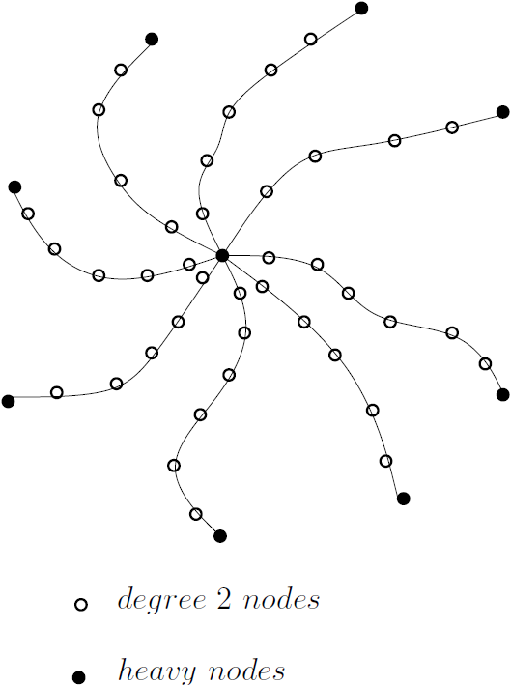
The nbr-hood of a heavy node

Slide 132
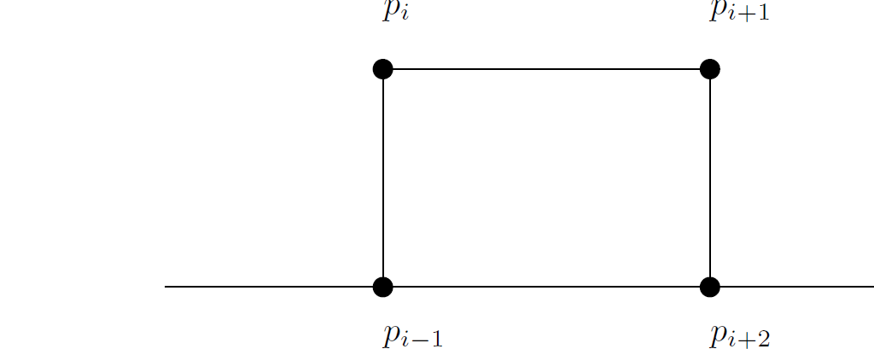
Lower bound
  Adversary’s strategy
    S₂: Creating ambiguity in layout by means of handles
A handle

